Slide 1
National STEM Honor SocietyTM
TM
© National STEM Honor SocietyTM

Slide 2
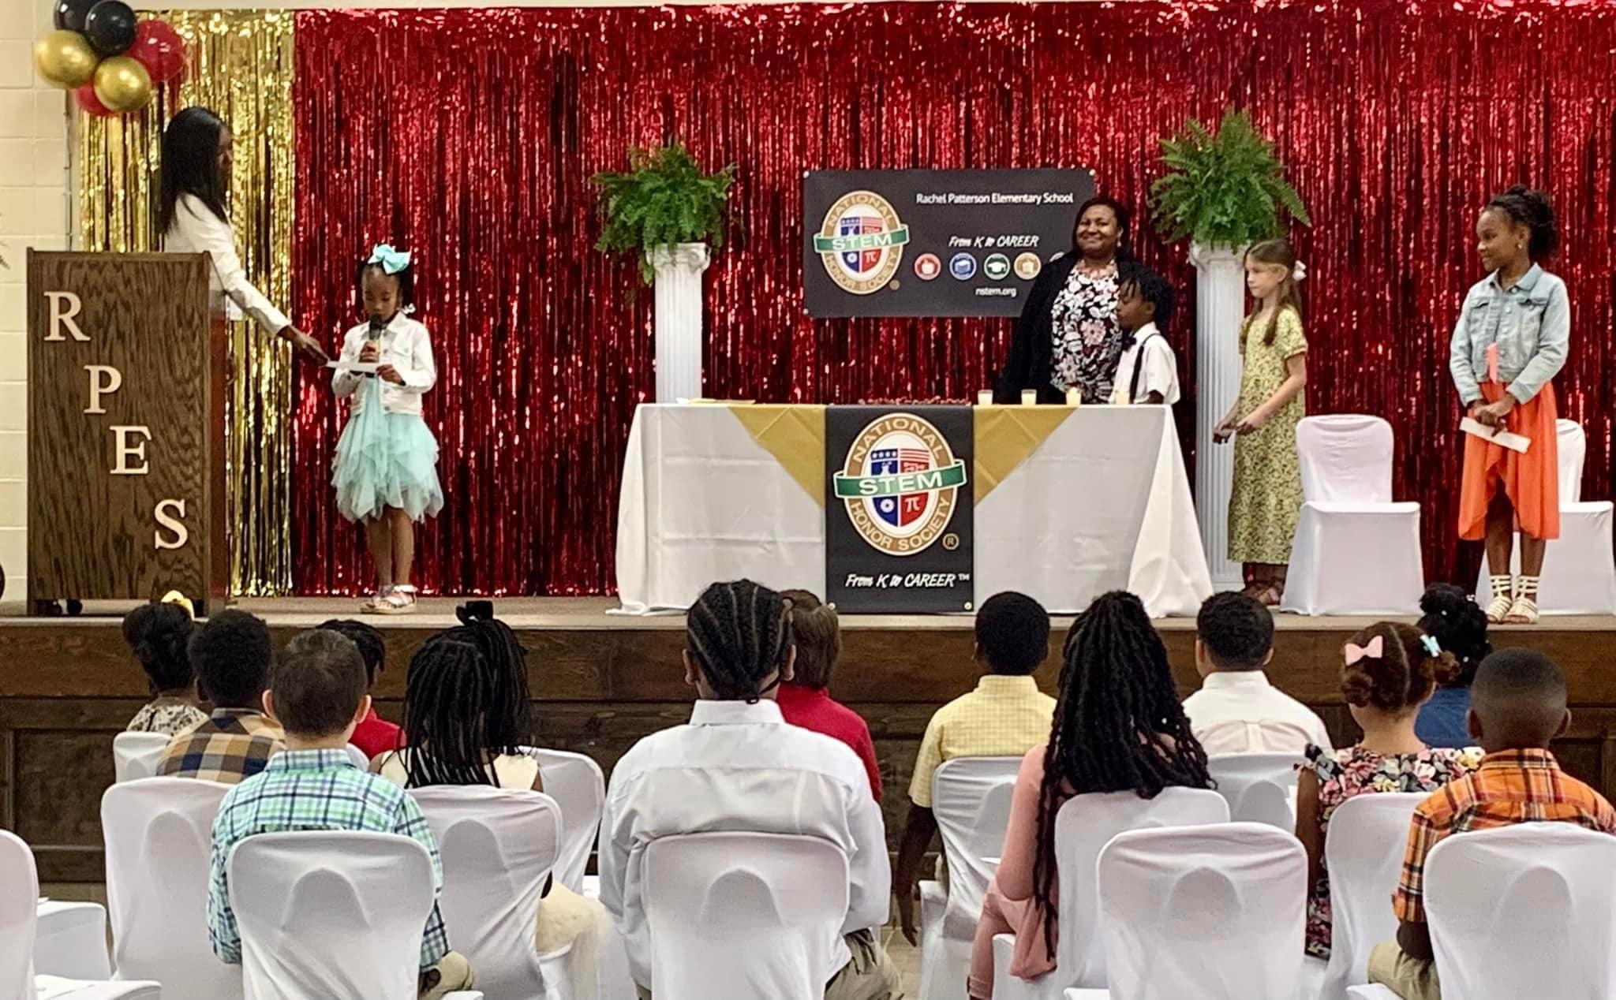
Rachel Patterson Elementary School - Chapter Induction Ceremony
Mission: Inspire innovation and recognize student excellence
From K to Career in the fields of Science, Technology, Engineering, & Mathematics.
© National STEM Honor SocietyTM

Slide 3
TM
© National STEM Honor SocietyTM
Notes:
Provides support and resources to students from K to CareerTM
Encourages STEM interest, creativity, and passion!
Available to all, regardless of resources within the community

Slide 4
What is the State of STEM at your school?
© National STEM Honor SocietyTM
Notes:
Align careers with educational experiences
Engage students at an earlier age
Expand the continuum from K to CareerTM
Increase skills in technical areas

Slide 5
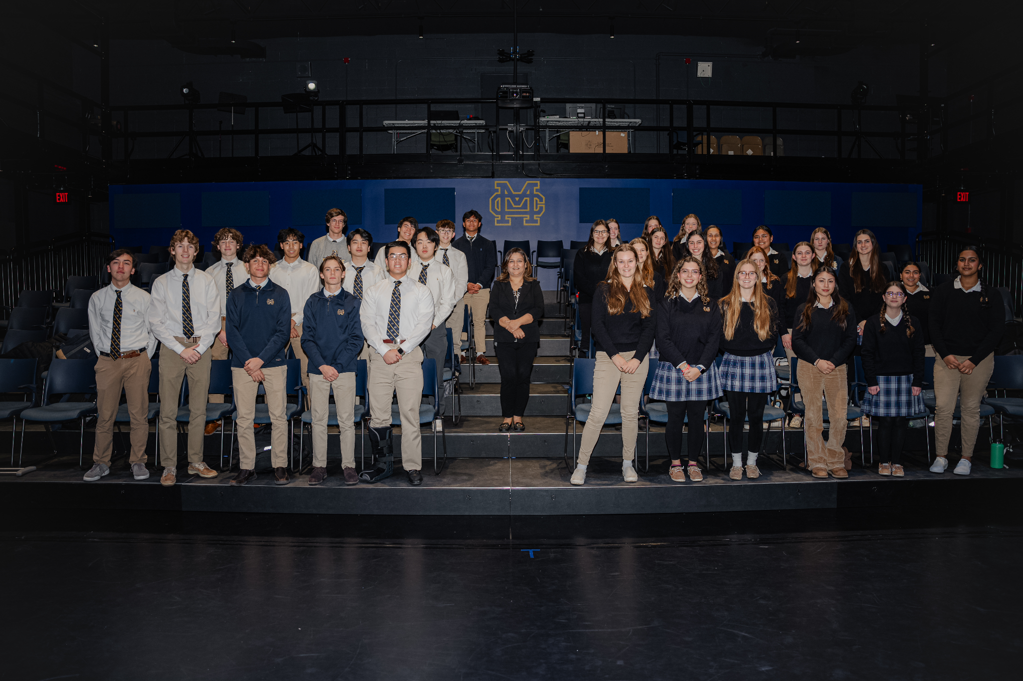
Chapter Based Society
Malden Catholic Graduation Ceremony
© National STEM Honor SocietyTM

Slide 6
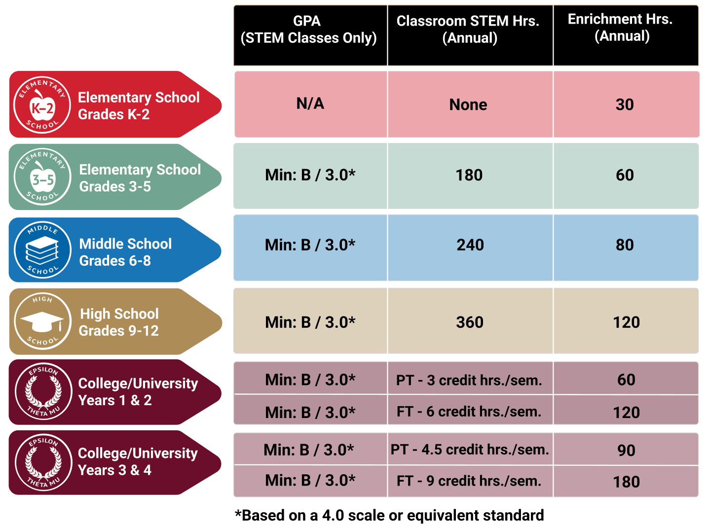
Annual Minimum
Eligibility
Requirements
for Student
Membership
© National STEM Honor SocietyTM

Slide 7
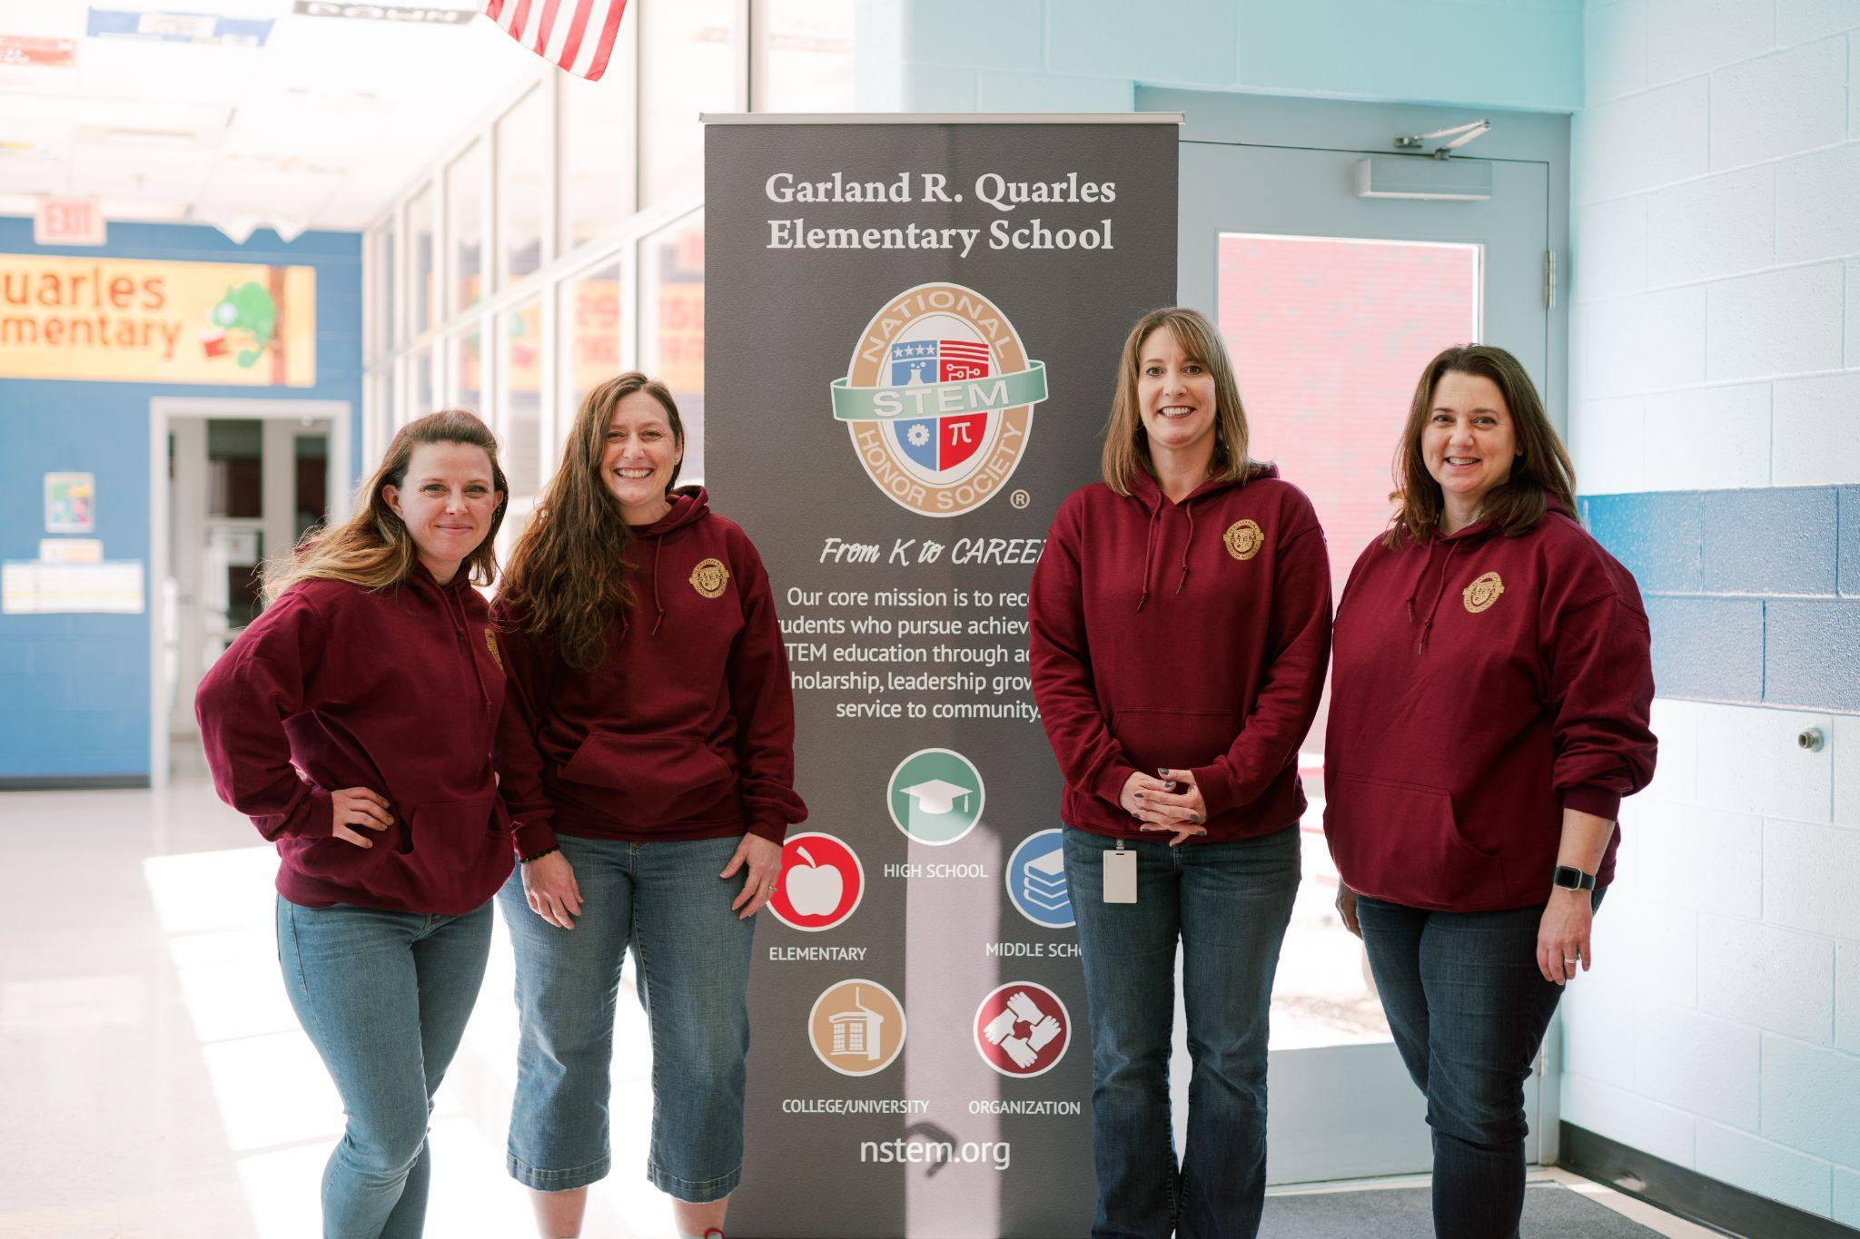
Teachers are Busy
Garland R. Quarles Elementary School
Winchester, VA
Chapter Director & Advisors
© National STEM Honor SocietyTM
Notes:
Being an educator is challenging, you’re busy!
We make your job easier by providing tools and resources to build and manage your Chapter
Help you create an engaging student experience!

Slide 8
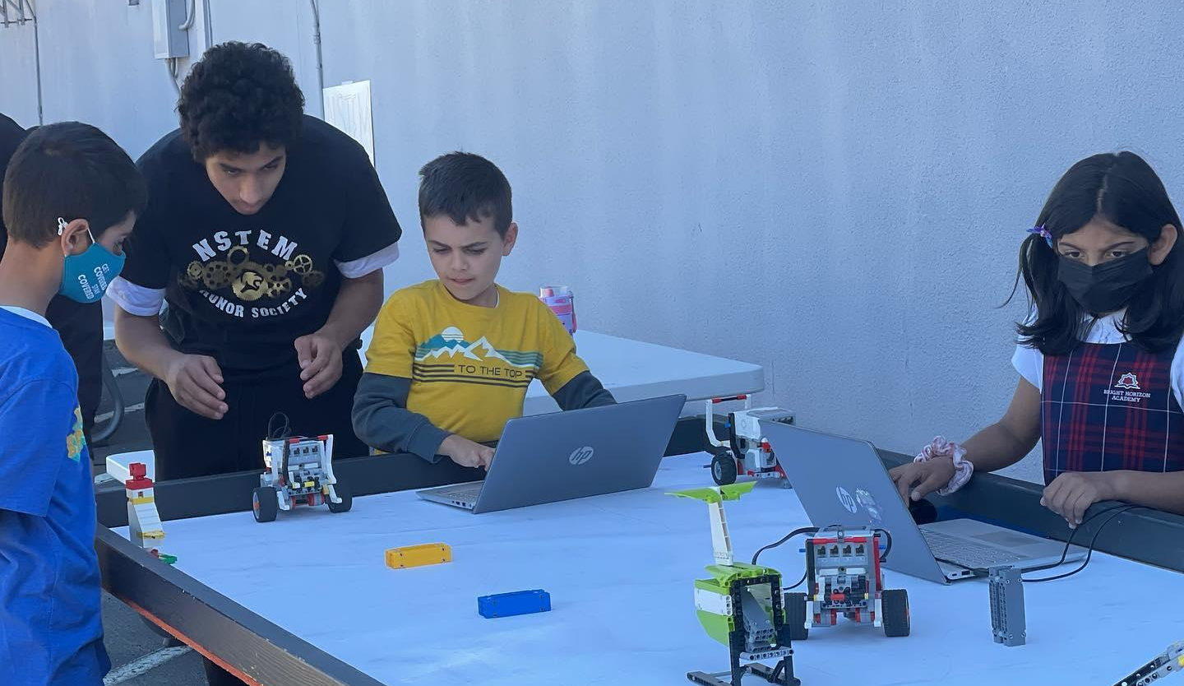
An “Honors” System for all Learners
Bright Horizon Academy/Islamic School of San Diego NSTEM Chapter
© National STEM Honor SocietyTM
Notes:
NSTEM is designed for ALL STEM learners
GPA requirement is only in STEM courses
Inclusive to all communities that want to participate in STEM education and training

Slide 9
Constitution & Bylaws
© National STEM Honor SocietyTM

Slide 10
Recognition
Project-Based Learning
Encourage Service
Resources
Future Readiness
Leadership
Awards/Scholarships
Benefits &
Value
Proposition
© National STEM Honor SocietyTM

Slide 11
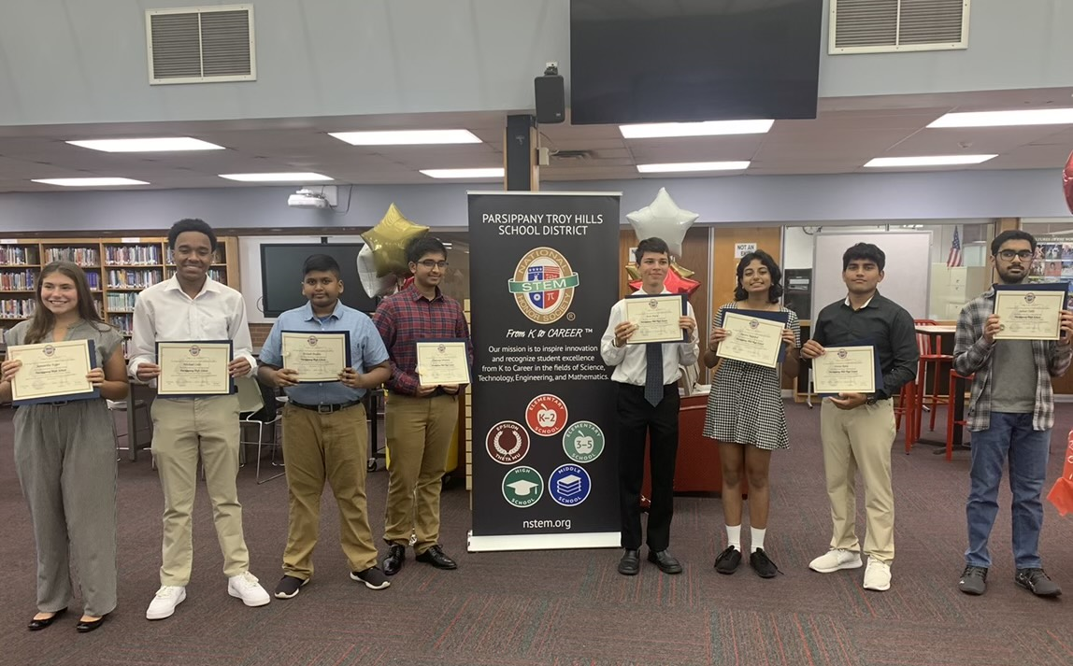
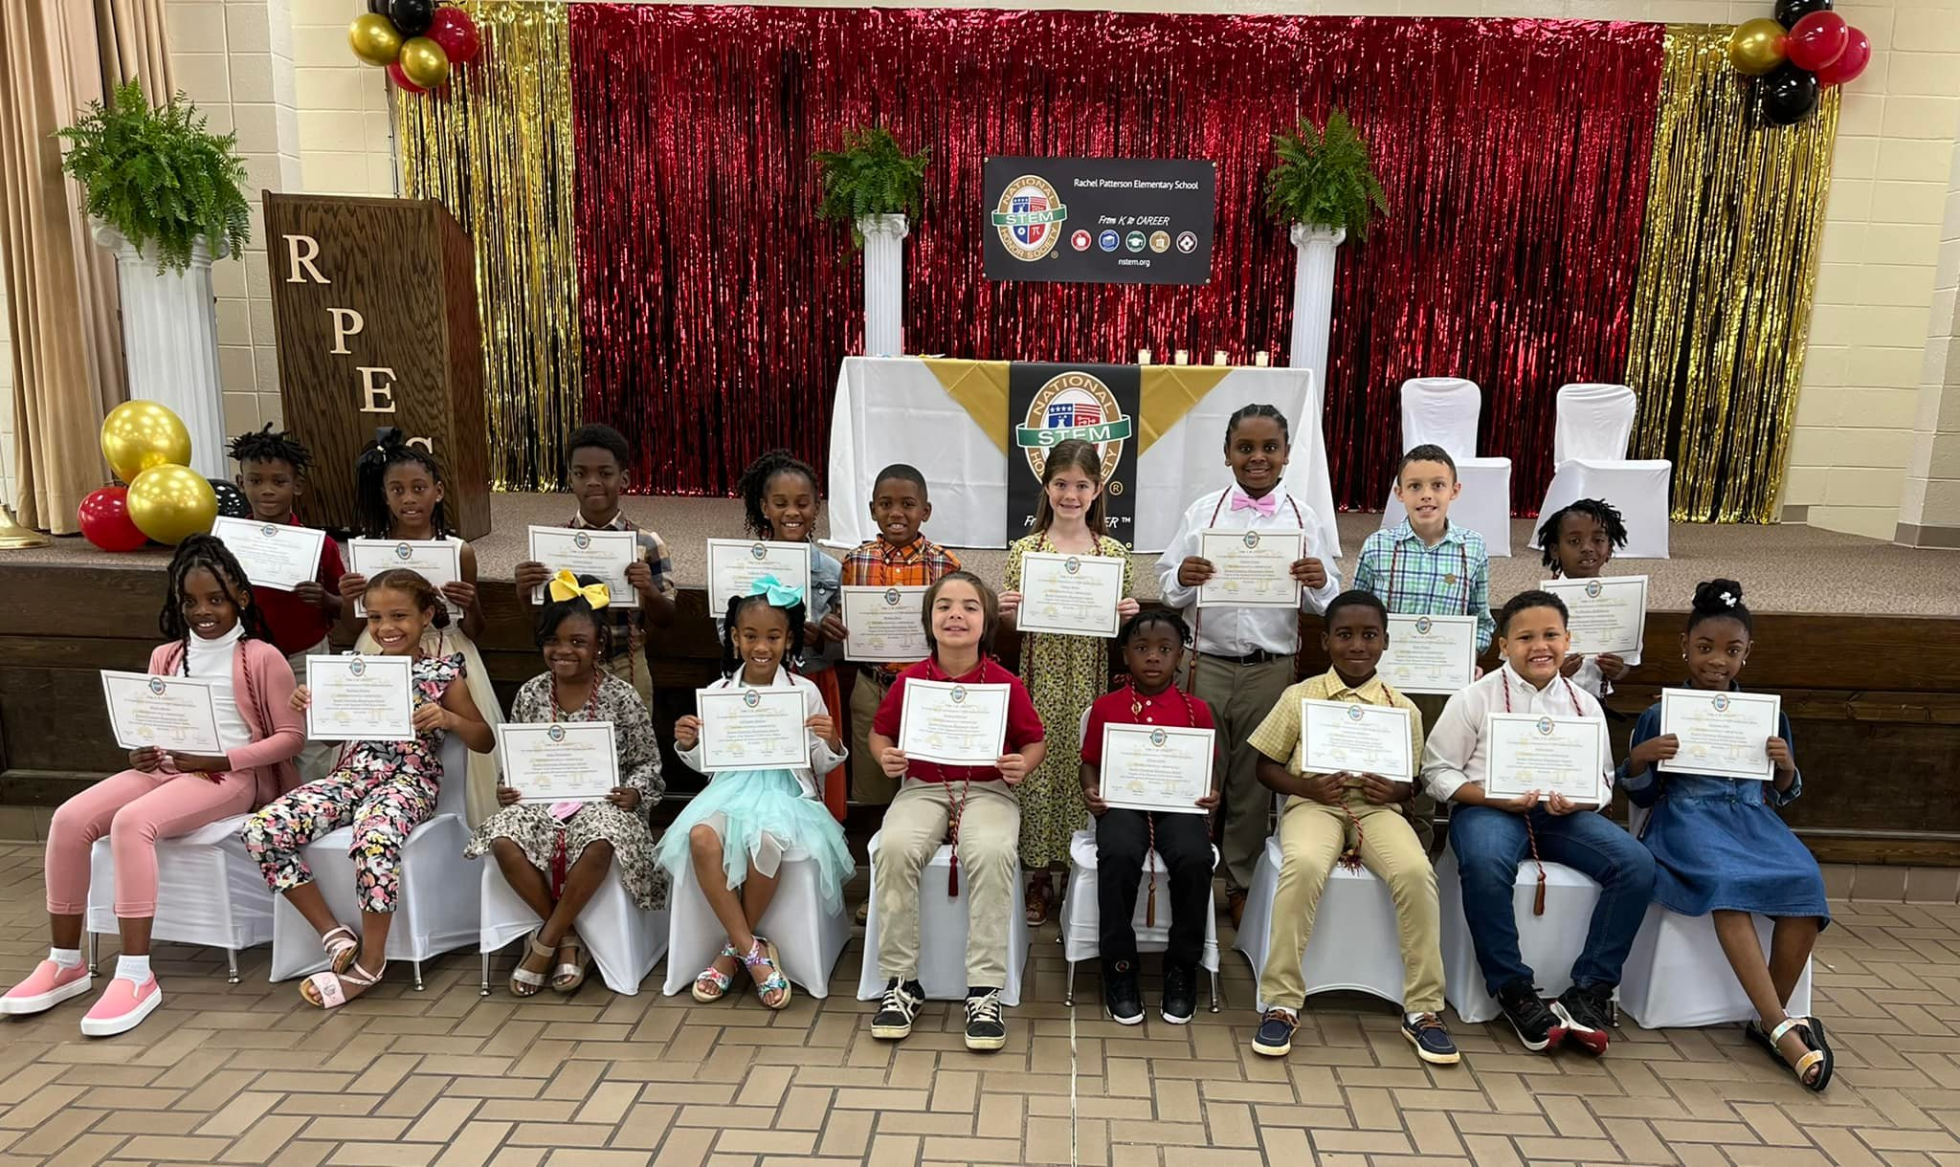
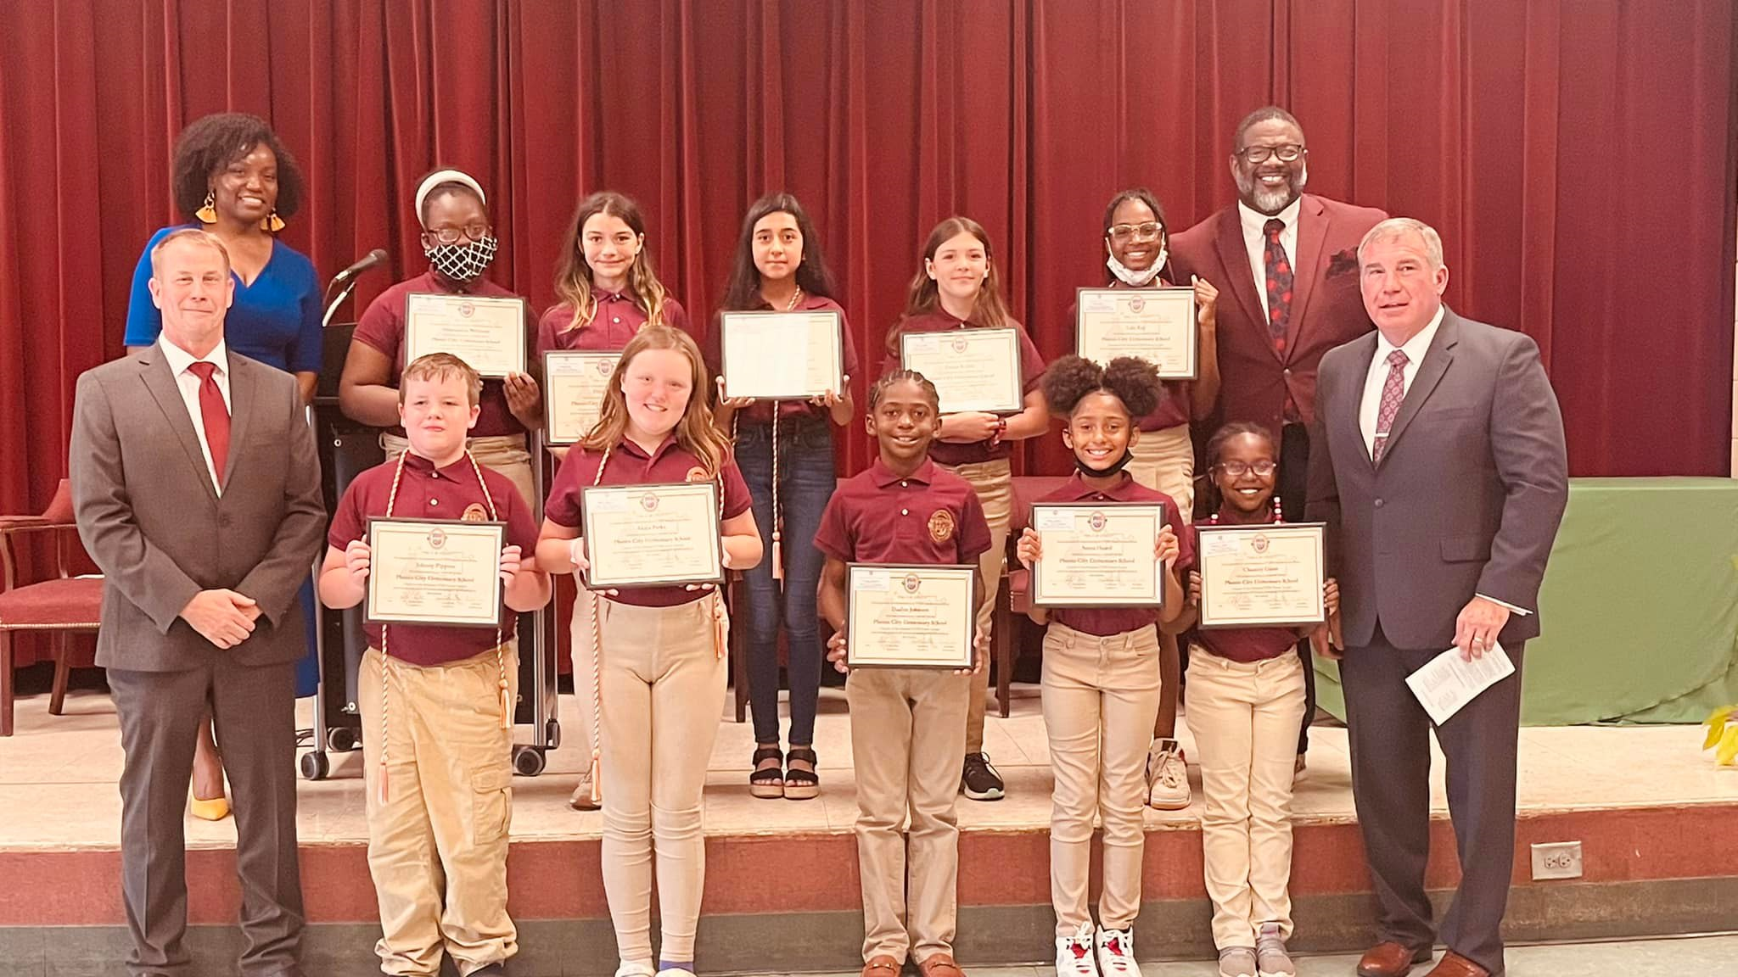
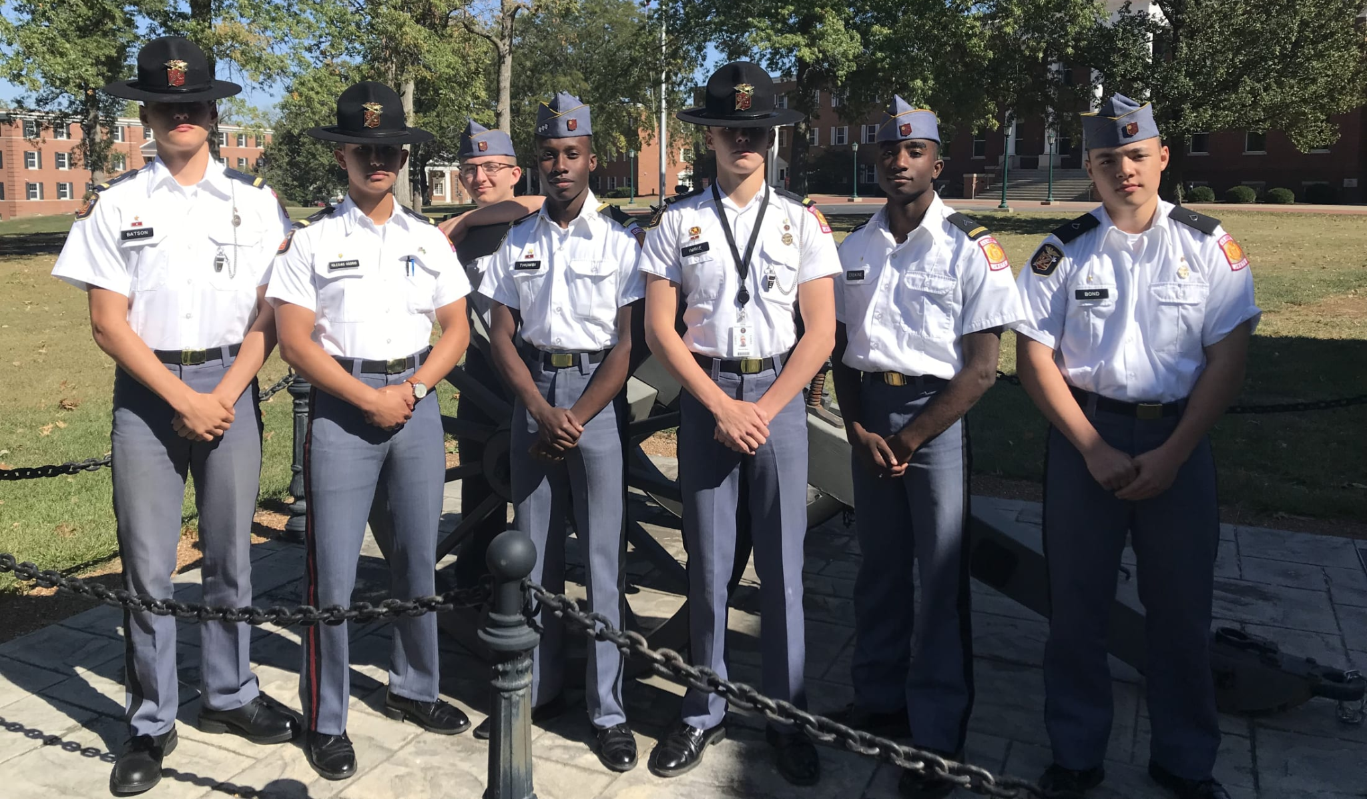
Recognition
Parsippany Troy Hills HS Induction Ceremony
Rachel Patterson Elementary Graduation Ceremony
Missouri Military Academy Officers Ceremony
Phenix City Elementary Induction Ceremony

Slide 12
Project-Based Learning
© National STEM Honor SocietyTM

Slide 13
Leadership
© National STEM Honor SocietyTM
© National STEM Honor SocietyTM

Slide 14
Leadership
Encouraging Service to solve local, regional, national, global problems/challenges
© National STEM Honor SocietyTM

Slide 15
Resources
© National STEM Honor SocietyTM

Slide 16
Future Readiness
© National STEM Honor SocietyTM

Slide 17
Leadership
Leadership
© National STEM Honor SocietyTM
© National STEM Honor SocietyTM

Slide 18
Chapter Officers
© National STEM Honor SocietyTM

Slide 19
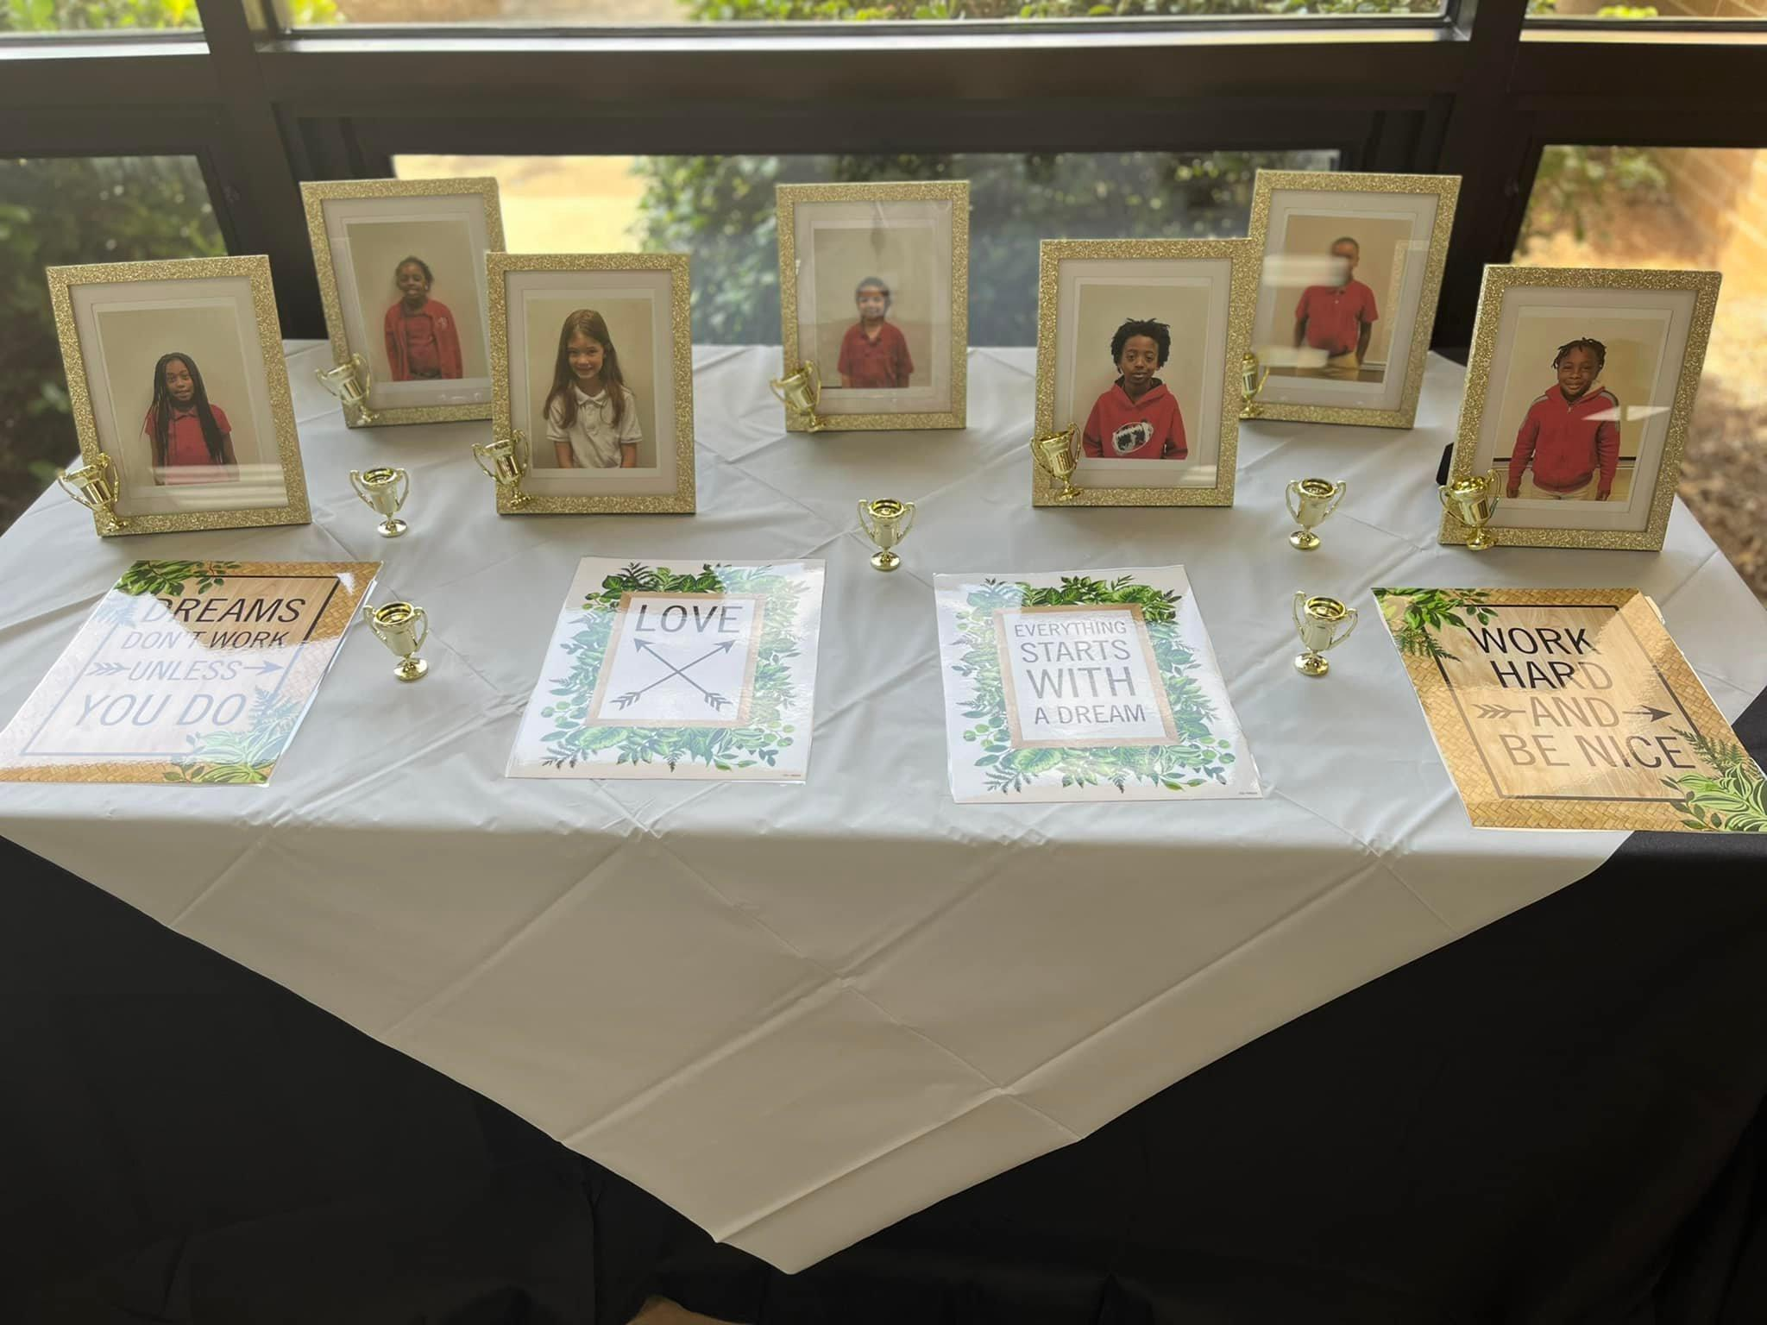
Awards & Scholarships
Rachel Patterson Elementary School NSTEM Chapter Induction Ceremony
© National STEM Honor SocietyTM
Notes:
NSTEM provides STEM scholarships for exemplary students!
College/University Scholarship
Extracurricular STEM Enrichment Scholarship

Slide 20
3 Commitments
®
© National STEM Honor SocietyTM

Slide 21
Affordability
© National STEM Honor SocietyTM
© National STEM Honor SocietyTM
Notes:
Annual Chapter fee = $295
Maximum student member fee is $20 (optional)
Equitable and accessible for all

Slide 22
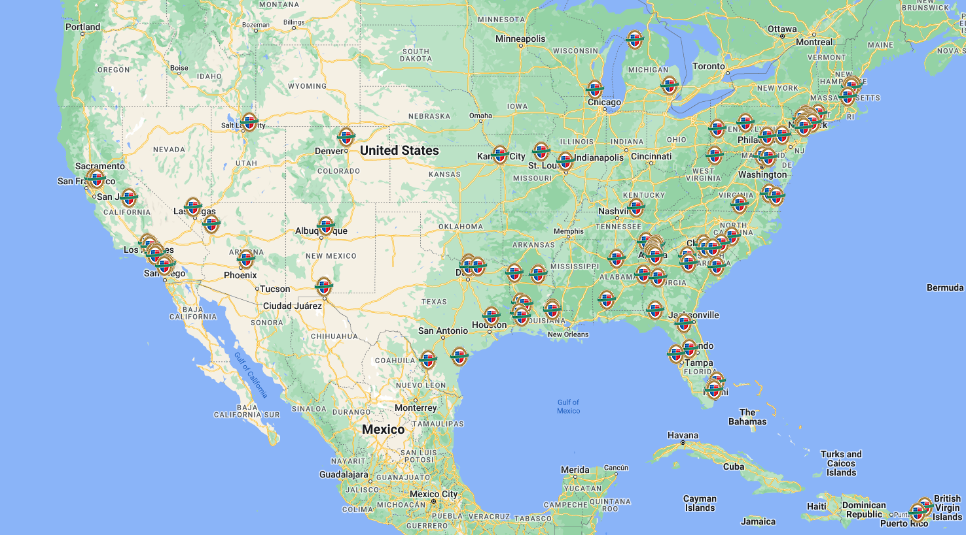
Leadership
Chapter
Map
© National STEM Honor SocietyTM

Slide 23
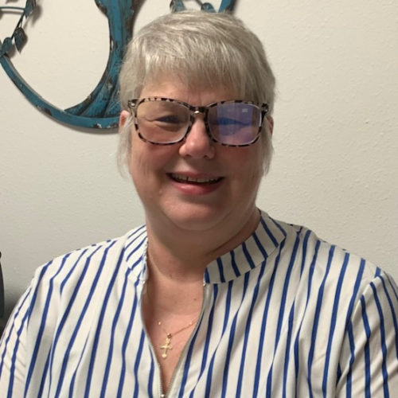
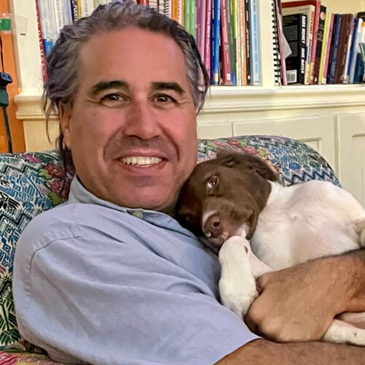
Member
Care
Patricia Kitchens
Director Chapter Services
33 year veteran teacher
Eric Magers
Founder/CEO
20 year veteran teacher
© National STEM Honor SocietyTM

Slide 24
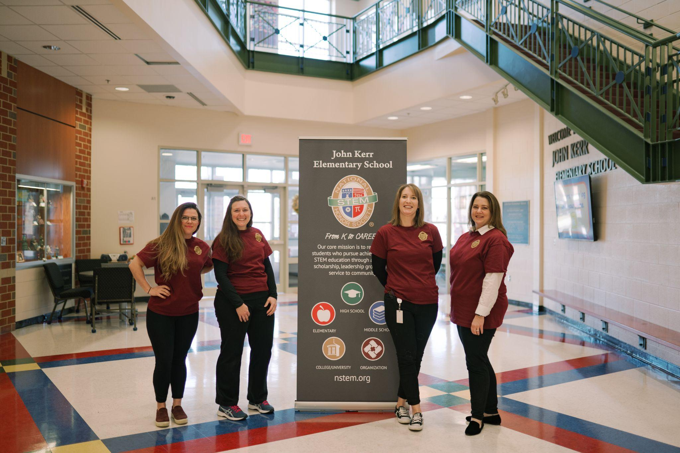
Managing Your Chapter
John Kerr Elementary School NSTEM Chapter Advisors
© National STEM Honor SocietyTM

Slide 25
Exclusive
Chapter Merchandise
© National STEM Honor SocietyTM
Notes:
Made in Canva
Hoodies, T-shirts, Polos, and MORE!

Slide 26
Apparel & Accessories
© National STEM Honor SocietyTM
Notes:
Made in Canva

Slide 27
Eric Magers
CEO & Founder
Executive
Leadership
Ken Hecht
President
Advisory Council
Errika Moore
STEM Funders
Network
Saundra Lamb
Thurgood Marshall Trust
Dr. José Morey
Ad Astra
Dr. Maxine Cain
Chair
STEM Atlanta Women
Kelli List Wells
STEM Leadership Alliance
© National STEM Honor SocietyTM

Slide 28
Partners
Accreditations
& Partners
© National STEM Honor SocietyTM

Slide 29
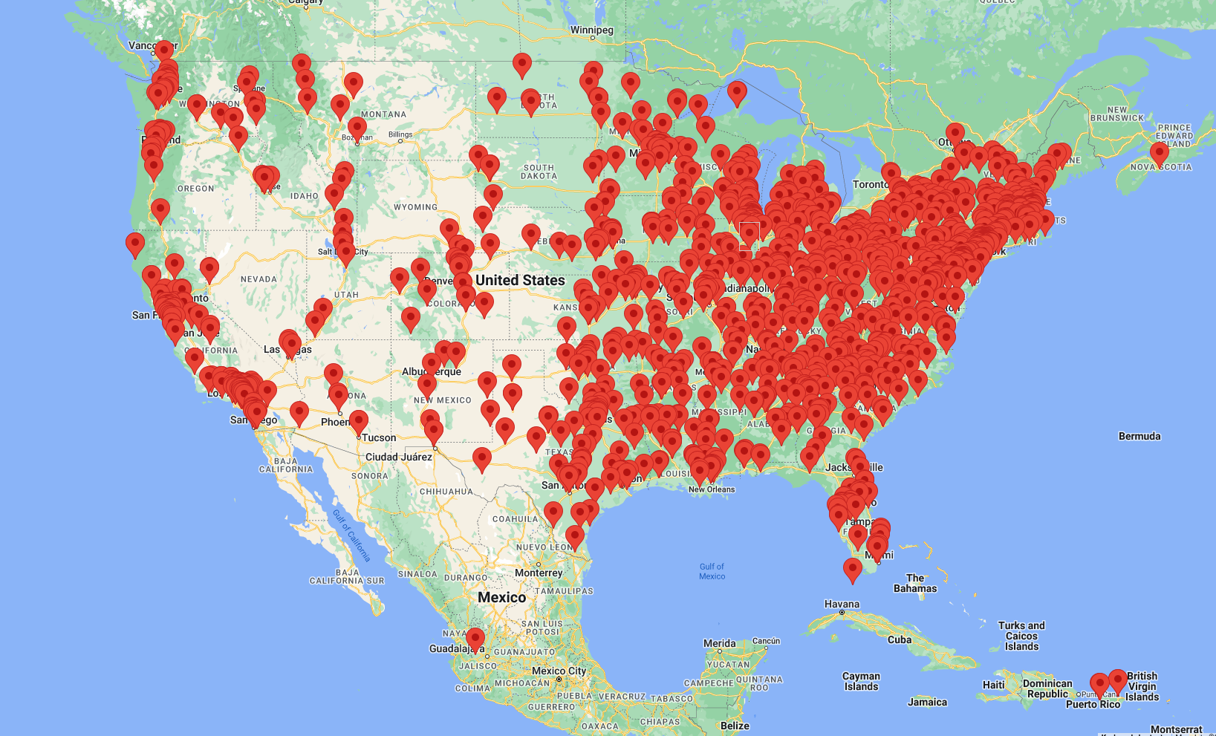
Accredited College
& University Internship
© National STEM Honor SocietyTM
Notes:
We hold accreditation from 1500 colleges and universities nationwide. Our official recognition by admissions boards solidifies our standing as a trusted and reputable institution for prospective students seeking academic excellence and growth

Slide 30
Starting a Chapter
Notre Dame Preparatory High
School, Scottsdale, AZ
© National STEM Honor SocietyTM

Slide 31
Thank You!
nstem.org
© National STEM Honor SocietyTM

