Slide 1



National STEM Honor SocietyTM
© National STEM Honor SocietyTM
Notes:
Everyone Introduce themselves and do student introductions + we all work at the National STEM Honor Society and Welcome!

Slide 2
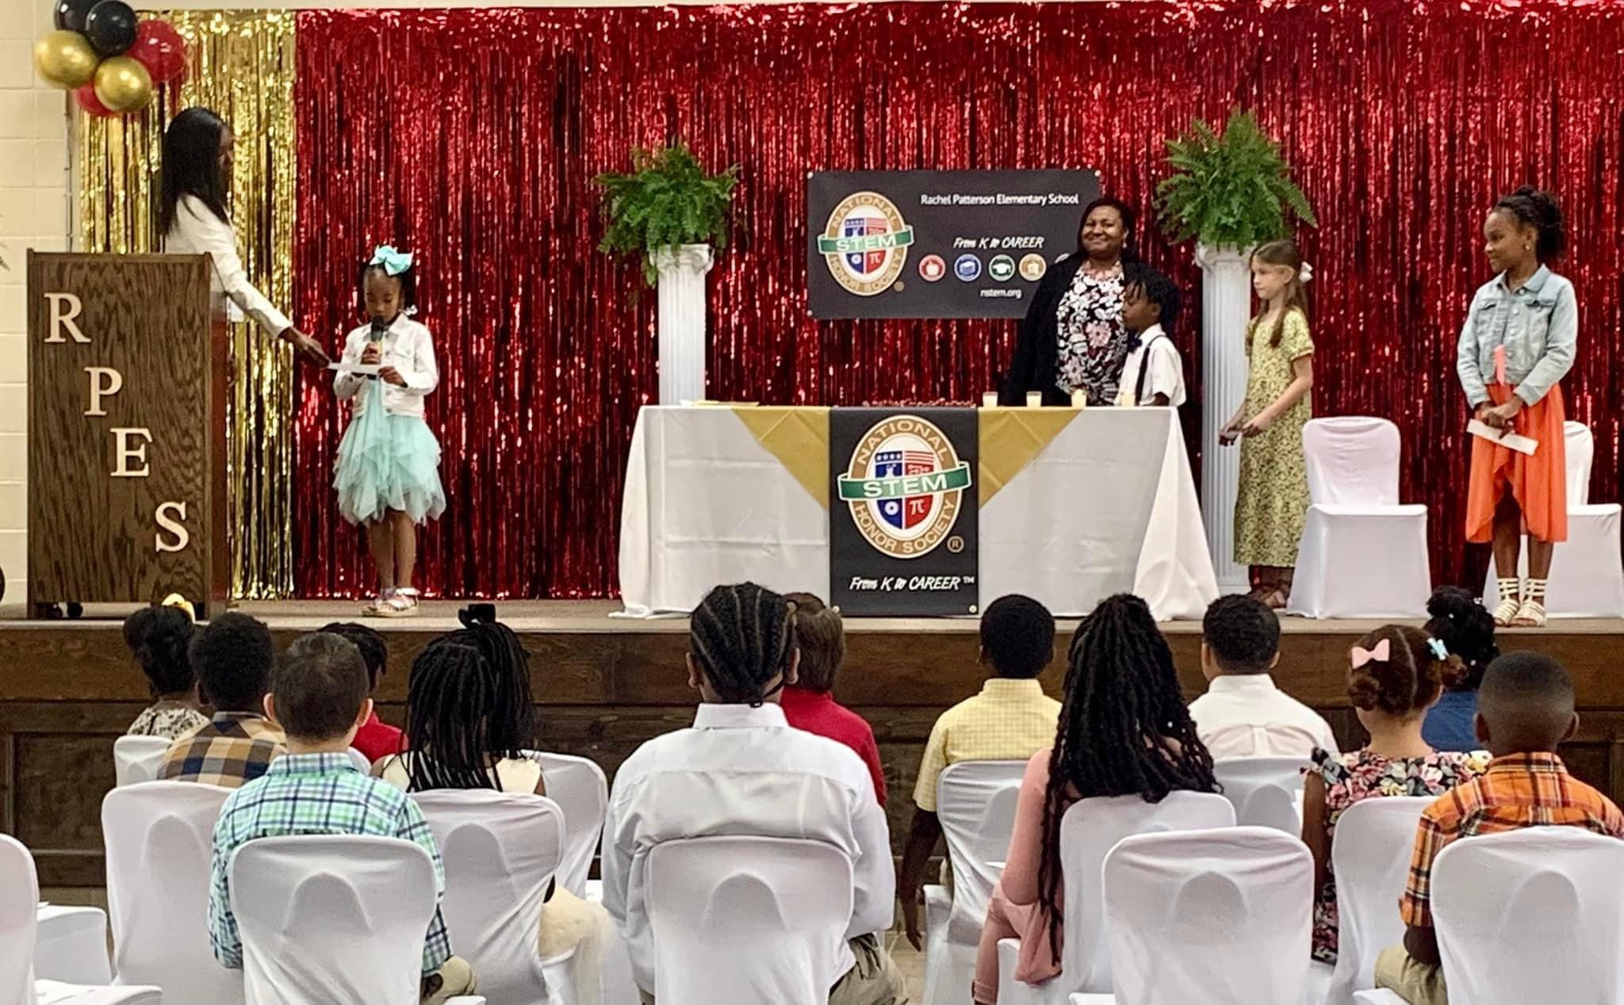
Rachel Patterson Elementary School - Chapter Induction Ceremony
Mission: Inspire innovation and recognize student excellence From Pre-K to CareerTM
in the fields of Science, Technology, Engineering, & Mathematics
© National STEM Honor SocietyTM

Slide 3






© National STEM Honor SocietyTM
Notes:
Provides support and resources to students from K to CareerTM
Encourages STEM interest, creativity, and passion!
Available to all, regardless of resources within the community

Slide 4

Students are busy!
© National STEM Honor SocietyTM
Notes:
Align careers with educational experiences
Engage students at an earlier age
Expand the continuum from K to CareerTM
Increase skills in technical areas
Making sure you have what you need to excel in STEM (students may find it hard to access resources)
New student dashboard is linked to the advisor dashboard so it is easy for them to keep up with everything
Dashboard is more user friendly

Slide 5

Chapters & Individual Global Membership
© National STEM Honor SocietyTM
Notes:
Easy to Join and accessible for everybody regardless of connection to physical school
This is a great opportunity for pre-k–12 international, online, or homeschooled students to receive STEM recognition.
Talk about the benefits of the International Global Membership (project-based learning, resources, and scholarship opportunities students can access)
Alternative to a chapter
IGM is for students who don’t have access to a chapter and a chapter member is based off an advisor who directs the students
(pasted from slide after)
While there are multiple types of memberships available, you get access to the NSTEM community regardless of how you join
Both chapters and individuals get access to a variety of resources
Great way to connect with other like-minded students around the world

Slide 6
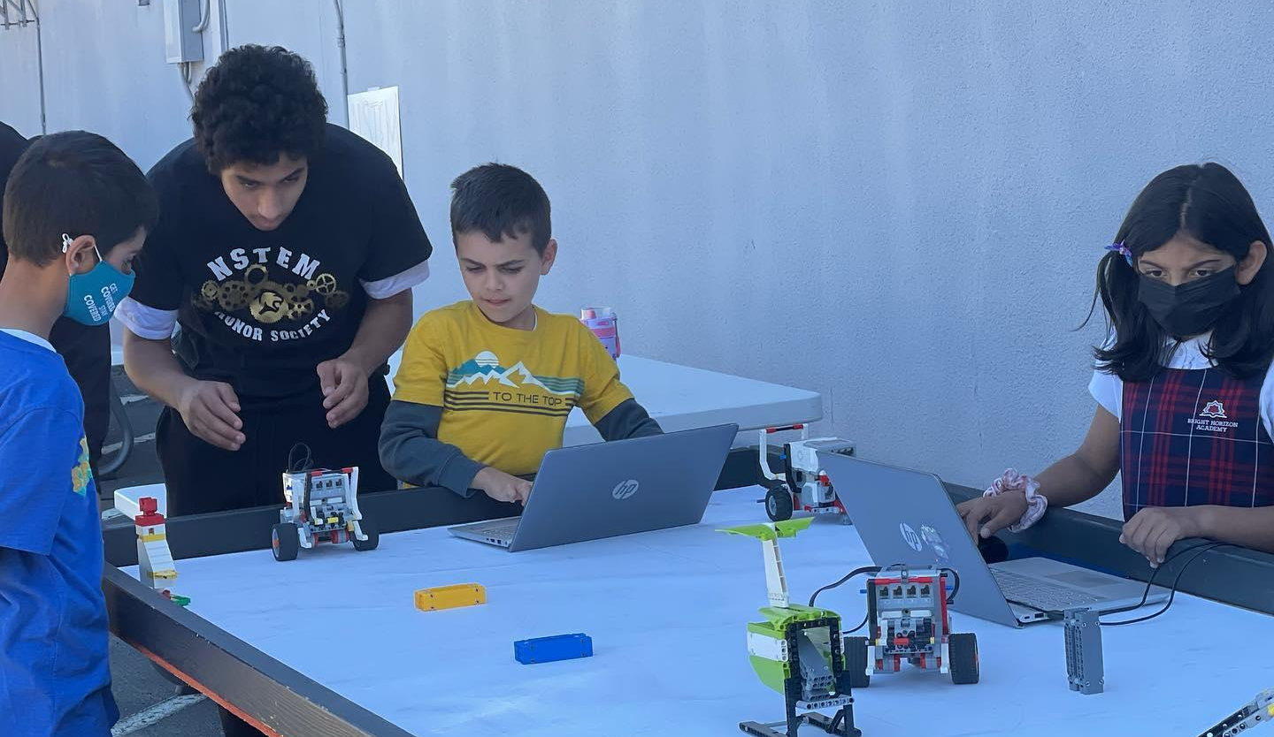
An Honors System for all Learners
Bright Horizon Academy/Islamic School of San Diego - Robotics Class
© National STEM Honor SocietyTM
Notes:
NSTEM is designed for ALL STEM learners
GPA requirement is only in STEM courses
Inclusive to all students that want to learn more about STEM
Everybody is welcome regardless of race, religion, status and the overall goal is to get as many students involved in STEM
Getting ready to go international with chapters all around the world

Slide 7

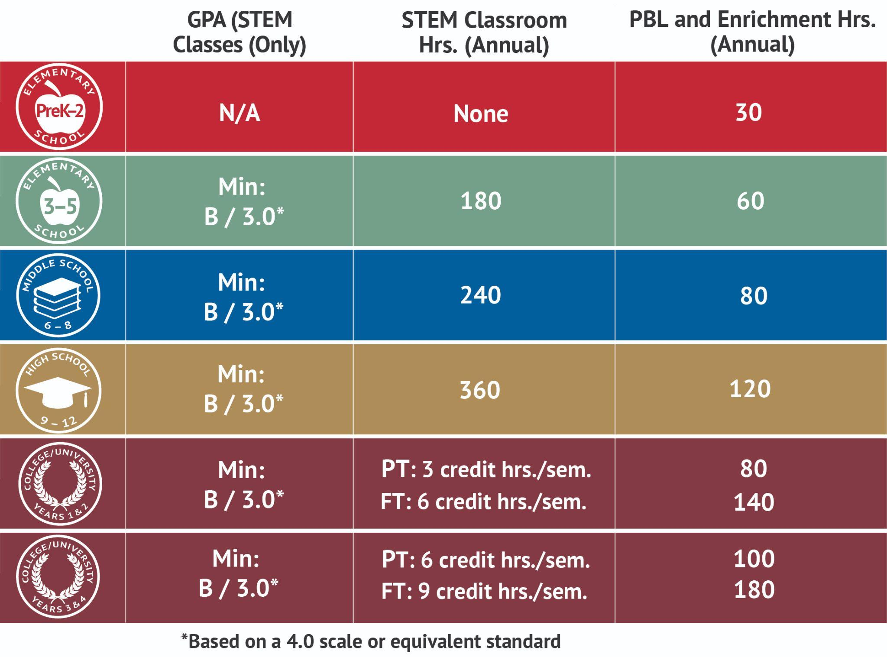
Annual Minimum Eligibility Requirements for Student Membership
© National STEM Honor SocietyTM
Notes:
Keep your grades up (regardless of whether you are IGM or chapter)
Keep member dashboards up to date (transition to slide 9)

Slide 8
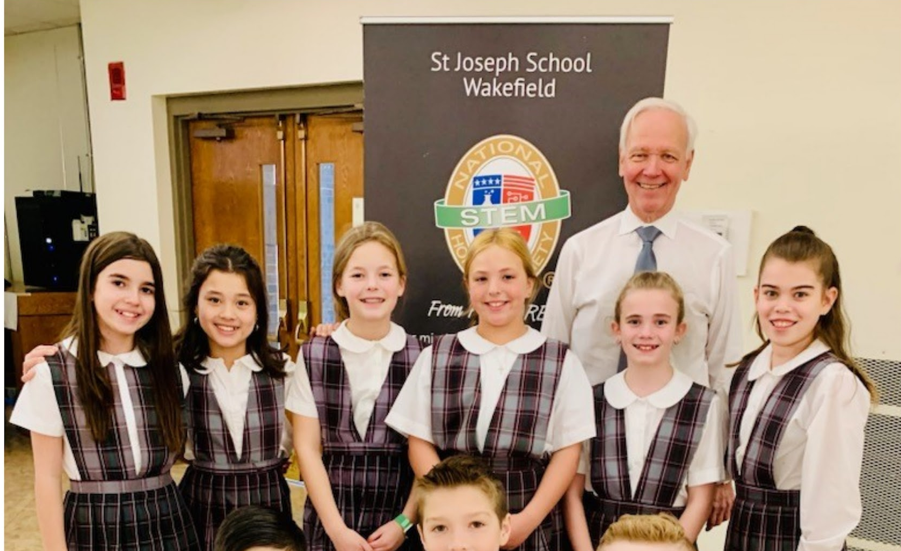
Student Dashboard
St. Joseph Middle School - Graduation Ceremony
© National STEM Honor SocietyTM
Notes:
Dashboards
What students can access
Chapter handbook
NSTEM products (Store)
Chapter experience form
Resource library
PBL showcase info
What they need to upload to stay active
Documentation to meet requirements
Media release

Slide 9

Parents
© National STEM Honor SocietyTM
Notes:
For members under the age of 13, your parents will have a pivotal role in working with you to make your STEM dreams possible
Parents will receive all email communications, so be sure to check your inboxes!
Parents can share in the responsibility for managing students’ dashboards and making sure their requirements are up to date (if an IGM)

Slide 10
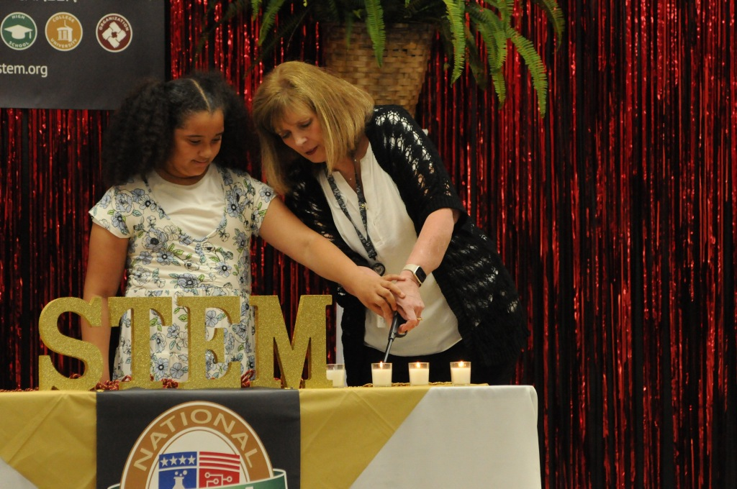








Benefits
© National STEM Honor SocietyTM
Notes:
Students are part of a worldwide community of learners and educators dedicated to STEM education and have access to many different benefits

Slide 11
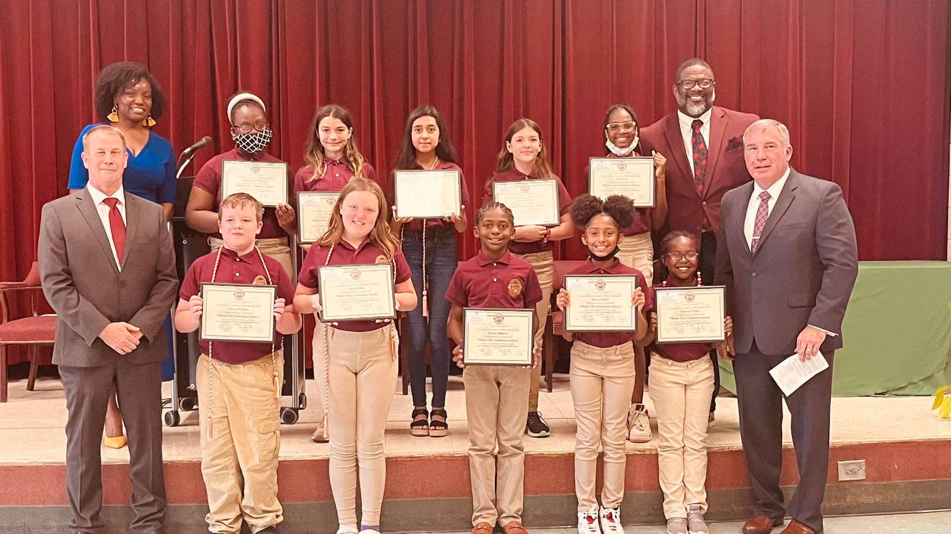
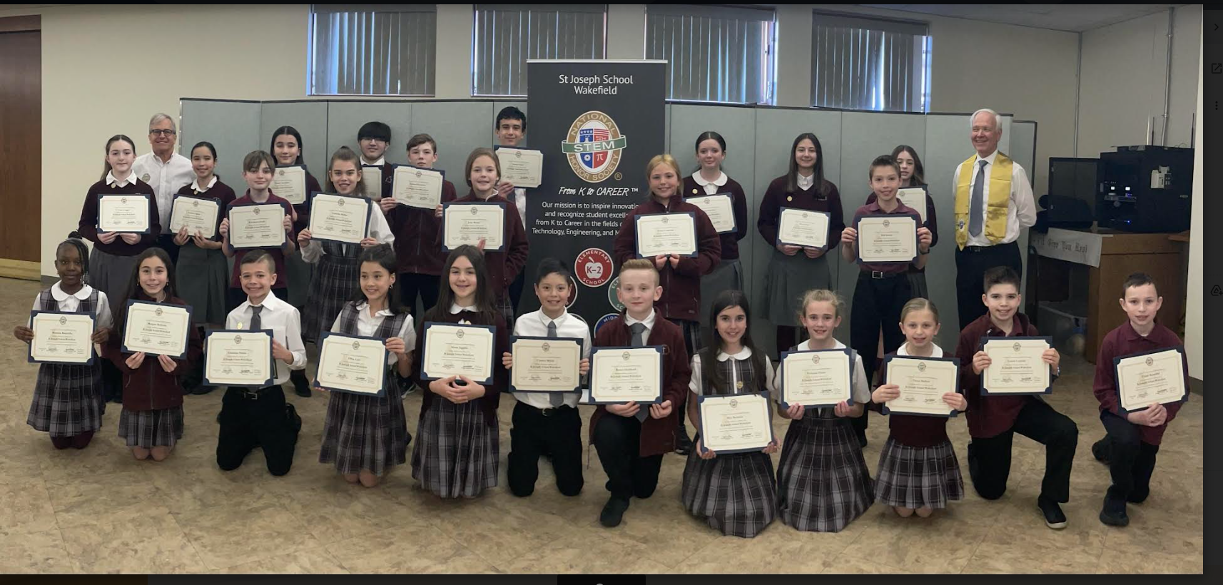
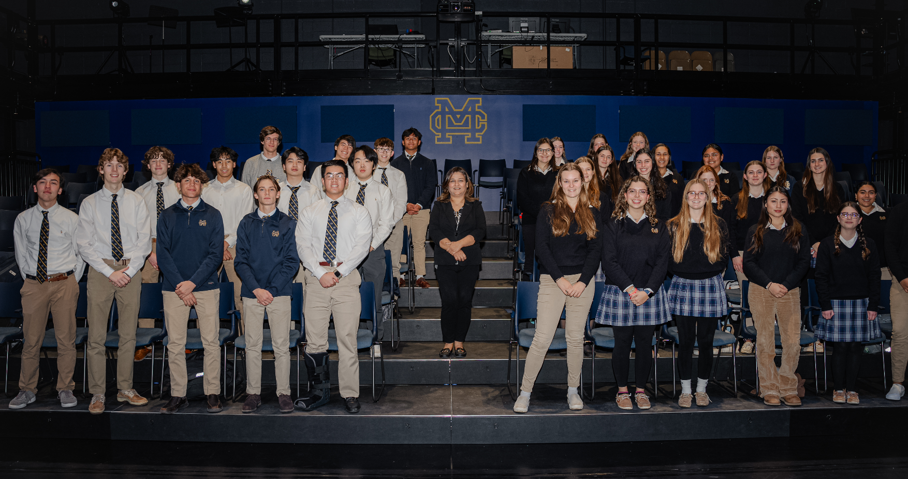
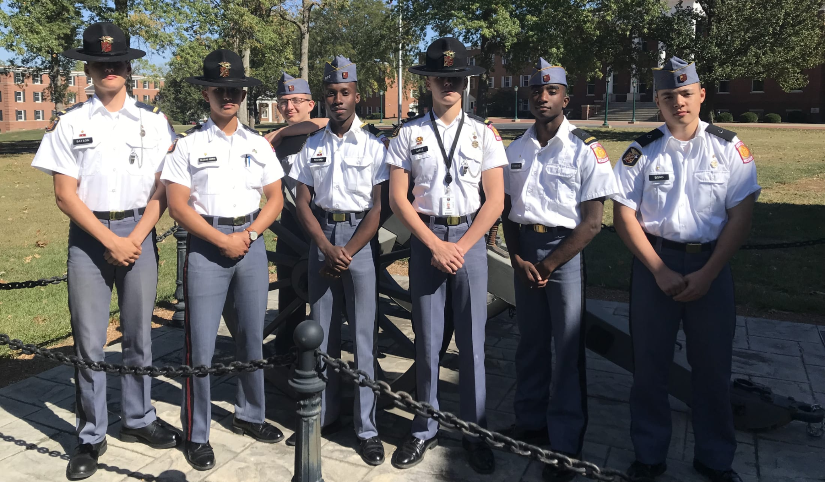
Phenix City Elementary - Induction Ceremony
St. Joseph Middle School - Induction Ceremony
Recognition
Phenix City Elementary - Induction Ceremony
Malden Catholic - Induction Ceremony
Missouri Military Academy - Officers Ceremony
Notes:
Students will get a welcome packet and certificate once accepted to a chapter or once their info is verified for IGM
Recognition - students get in the news
Induction and Graduation Ceremonies

Slide 12

Project-Based
Learning
© National STEM Honor SocietyTM
Notes:
One of NSTEM’s core values is project-based learning, where students get the opportunity to grow by hands-on opportunities
How does NSTEM contribute to PBL?
PBL showcase as recognition (tie to next slide)
Showing commitment to STEM and culmination of in depth learning throughout the year
Advisors have the ability to recognize excellence in project based learning through certificates and awards (mention shop)
Anyone can join regardless of school-based chapters or IGM

Slide 13

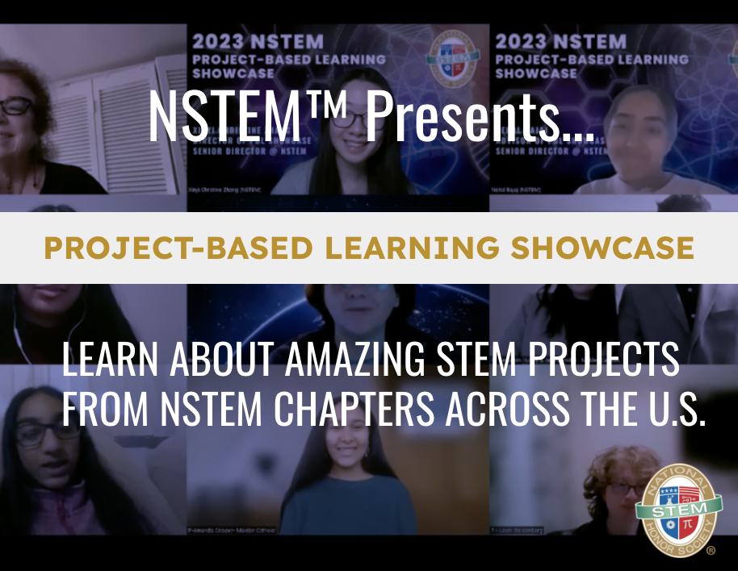
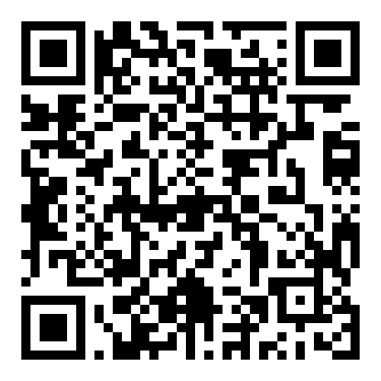
Leadership
© National STEM Honor SocietyTM
© National STEM Honor SocietyTM
Notes:
Annual showcase involving over 30 projects from across the United States
Students of any age can enter their STEM-related projects that they have completed over the past year and give a presentation, similar to a science fair
Culmination and showcase of STEM learning over the school year
Happens March of every year
To learn more - scan the QR code on this slide or check your student dashboard!
https://nstem.org/project-based-learning-showcase/

Slide 14
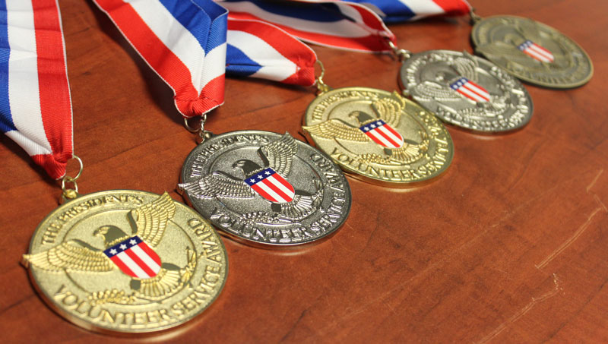

Leadership
Encouraging
Community Service
to solve local, regional,
national, global problems/challenges
© National STEM Honor SocietyTM
Notes:
Through an NSTEM membership students can easily earn a PVSA, which encourages community service for all students
PVSA’s are another way that we recognize excellence and its on a national level!

Slide 15

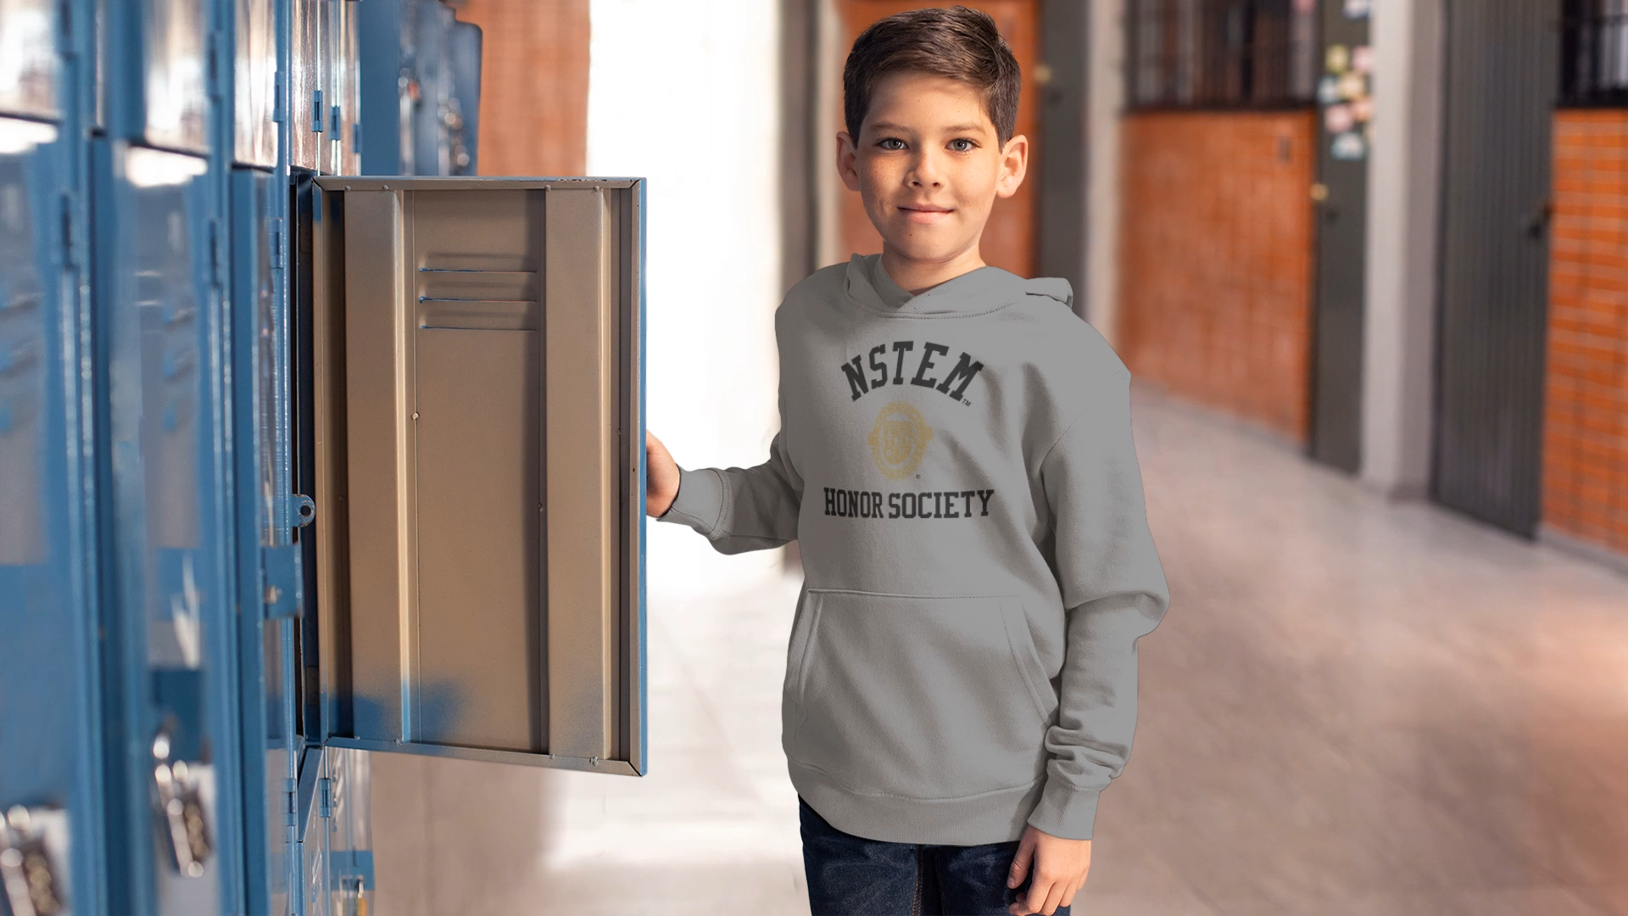






Leadership
Leadership
© National STEM Honor SocietyTM
Notes:
We’re not just focused on STEM education, we’re also focused on leadership (segue to next slide)
We help to establish leadership skills in students as early as pre-k and through college/university
Students will be invited to join the Student Advisory council
Chapter Officer is a great way (segue to next slide)

Slide 16

Tools
and
Resources
© National STEM Honor SocietyTM
Notes:
Resource Library (a great way for students to learn about STEM opportunities, e.g., external scholarships, events, competitions, etc.)
Student newsletter and monthly updates
We will help you plan fundraisers and recognize that not everybody has the financial resources to obtain things
Have an entire team dedicated to finding solutions for members and chapters . Email: membercare@nstem.org

Slide 17
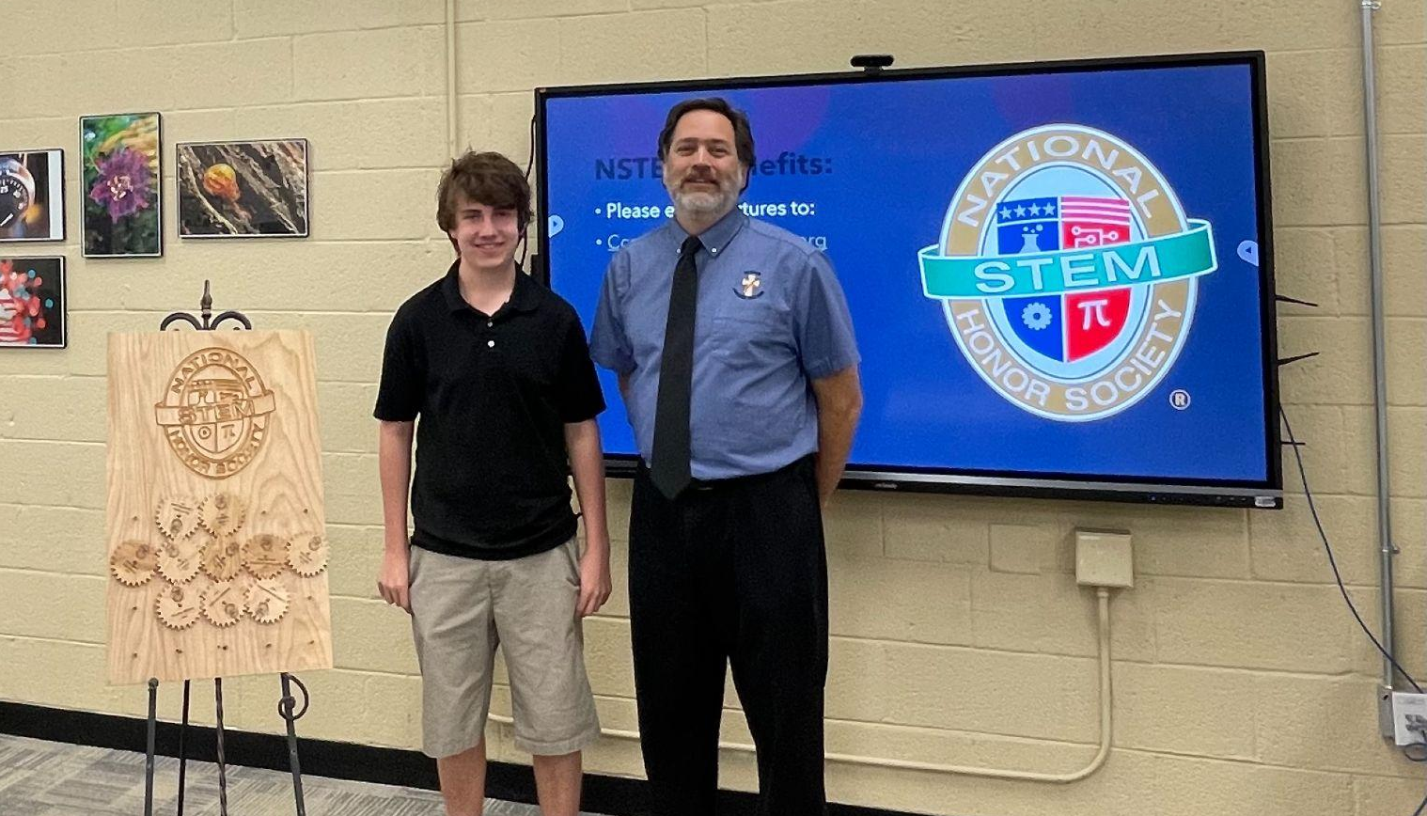
Resource Library
Notre Dame Preparatory High - Award Ceremony
© National STEM Honor SocietyTM

Slide 18




Product & Service Discounts
© National STEM Honor SocietyTM
Notes:
IGMs get discounts, chapter members get discounts too
Resource Library discounts
Store discounts (all new members have 10% off for apparel and accessories)

Slide 19
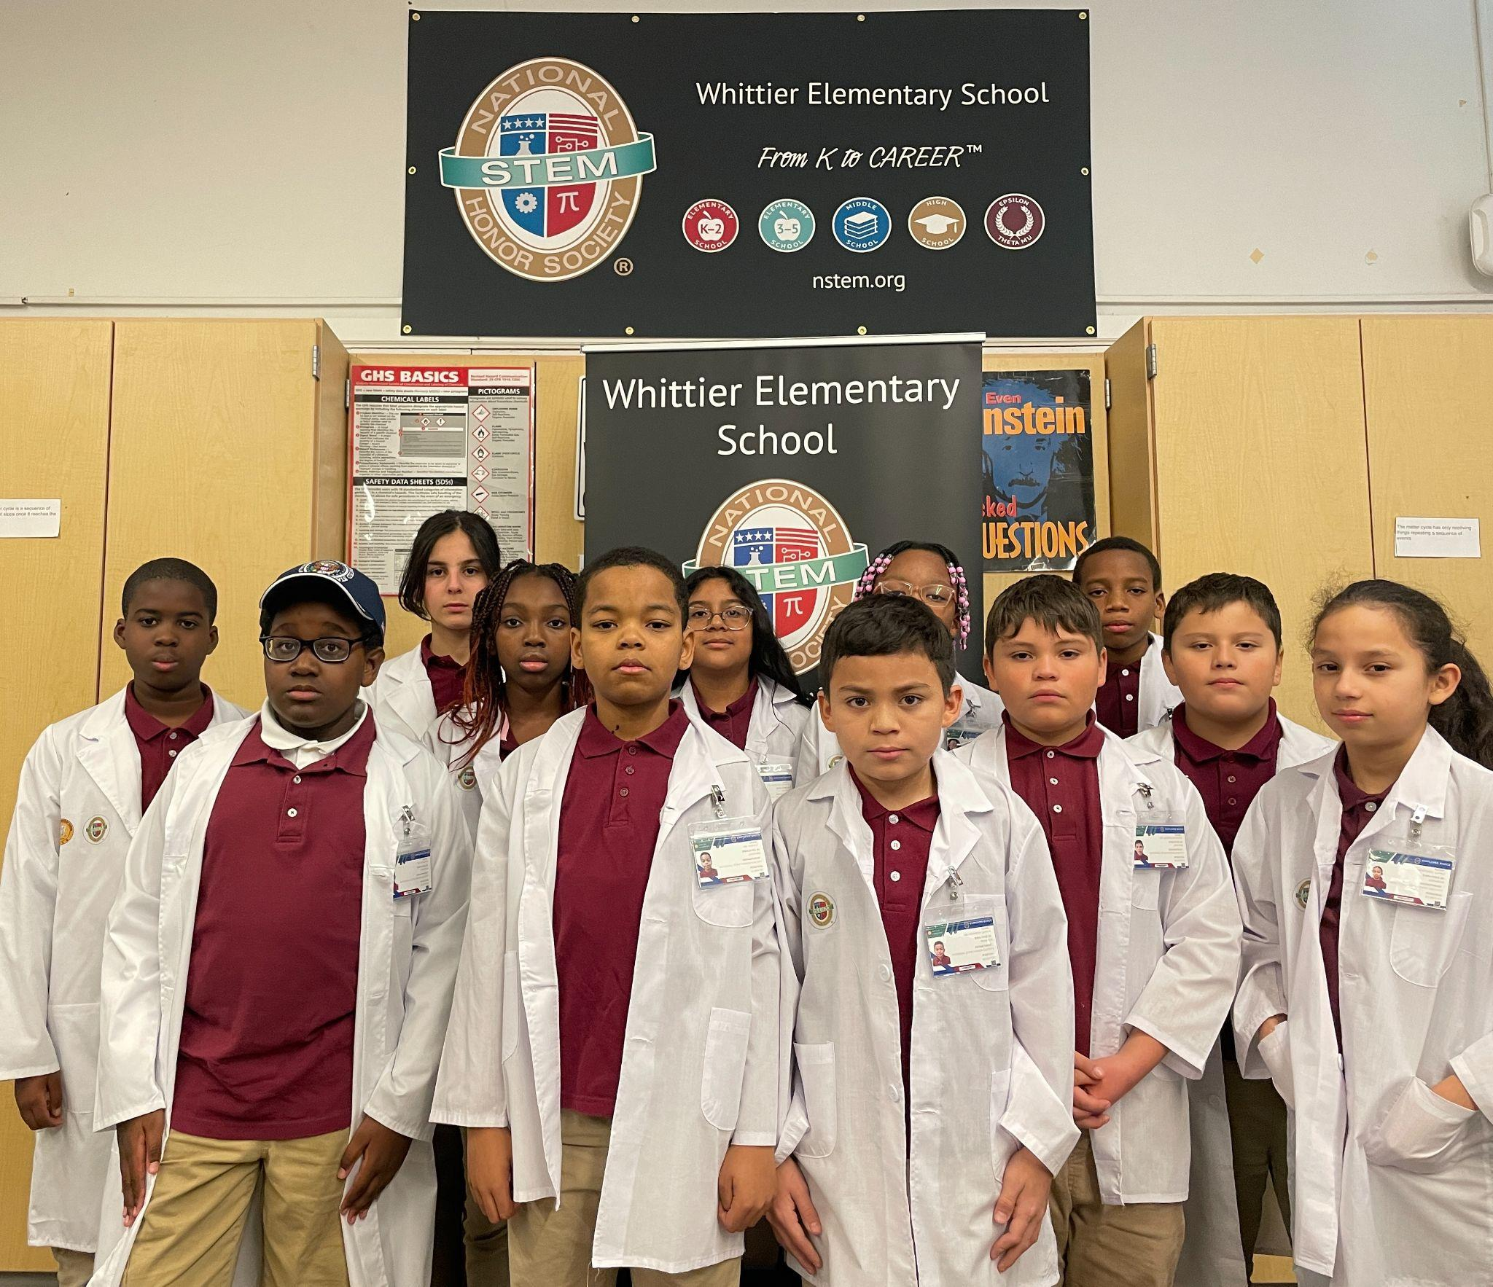
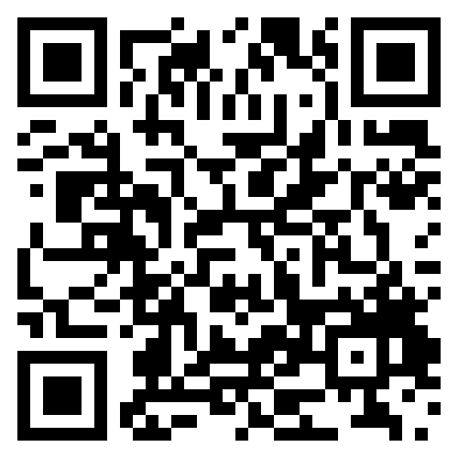
Future
Readiness
Whittier Elementary School -
Science Lab
© National STEM Honor SocietyTM
Notes:
Direct them to the Whittier Elementary School Youtube video (do a QR Code)

Slide 20





NSTEM’s Values
®
© National STEM Honor SocietyTM
Notes:
As an NSTEM member, while you are exploring your STEM career, you are also learning the crucial values that we, here at NSTEM, believe in: Community, the environment, and IDEA

Slide 21
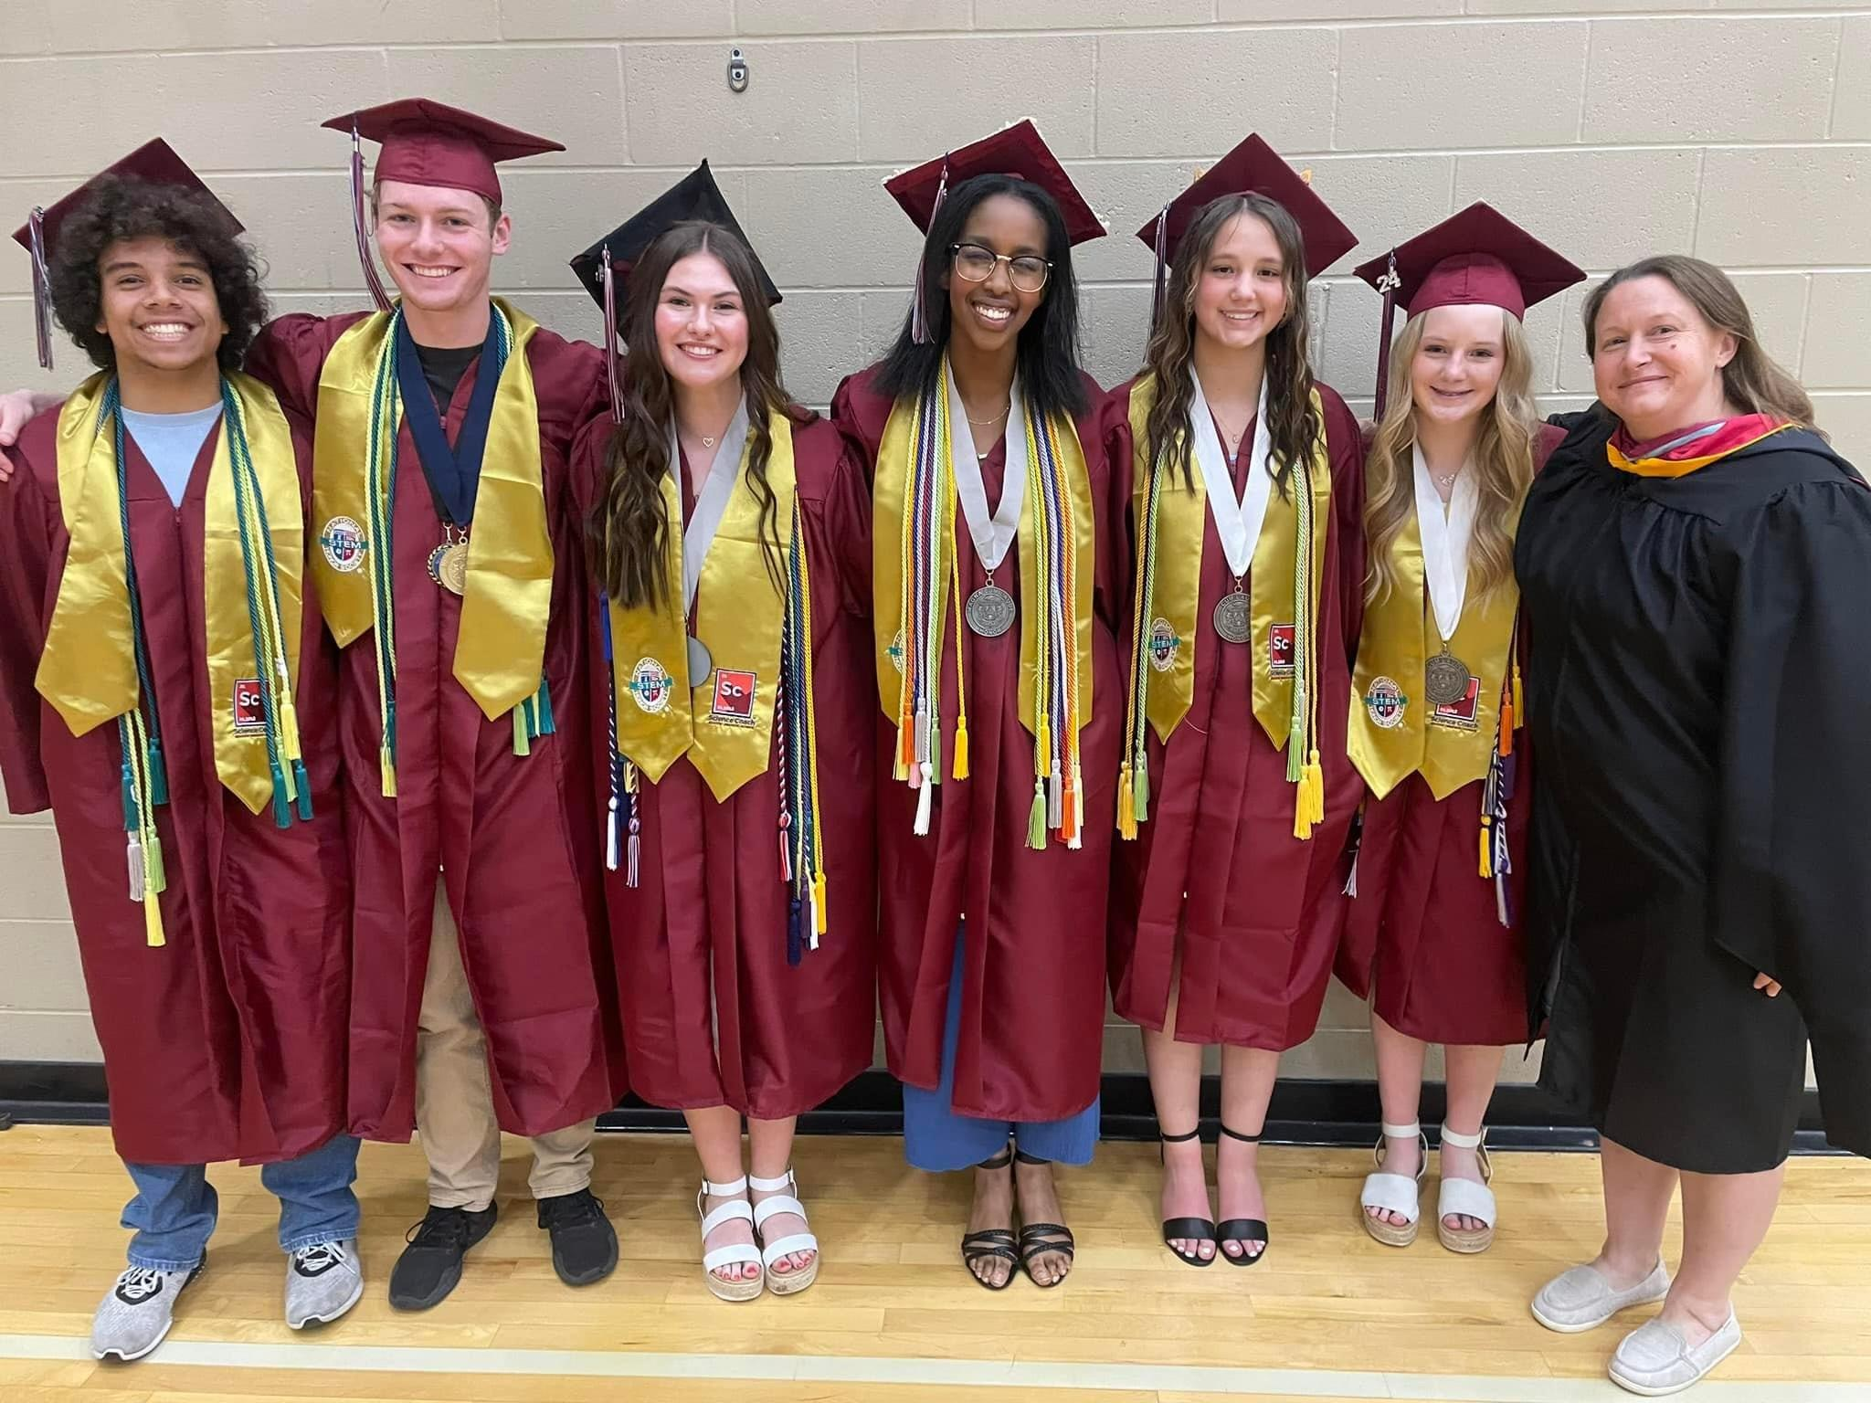
Affordability
© National STEM Honor SocietyTM
Notes:
We could talk about the “no student left behind” concept and how the grants and sponsorship team might be able to help them.
Fundraisers - we’re able to help provide ideas/resources
Prices are affordable for both chapters and IGM members

Slide 22
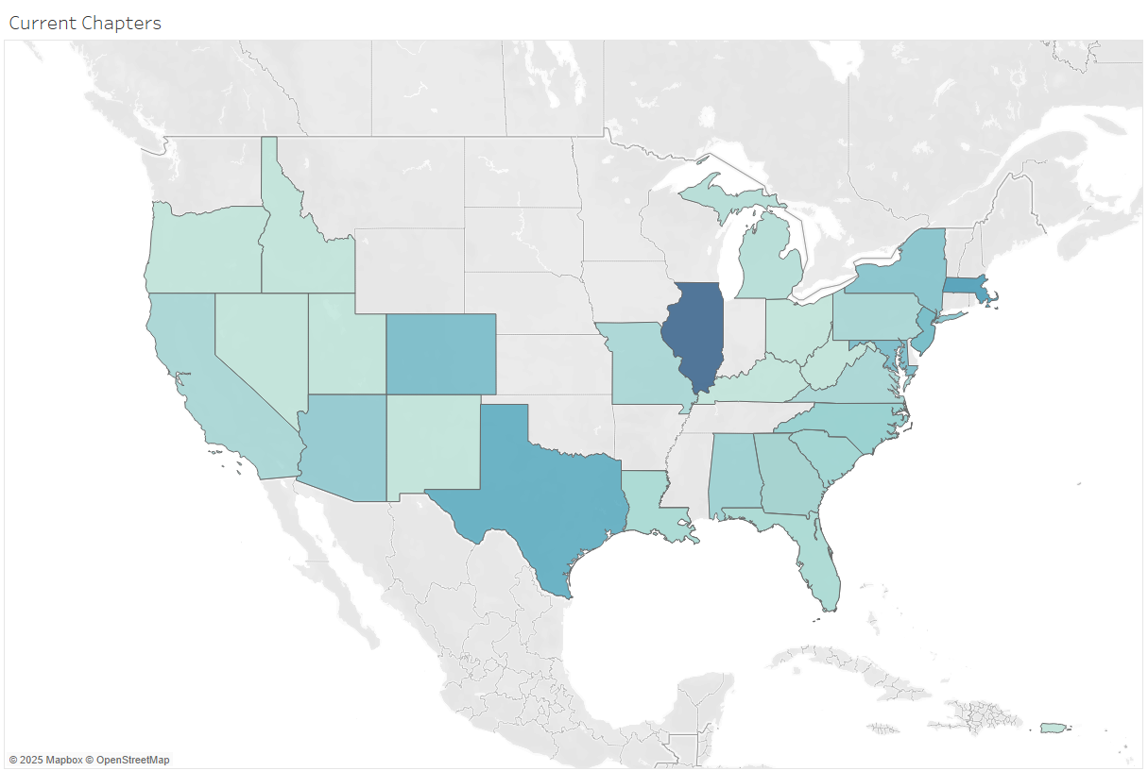
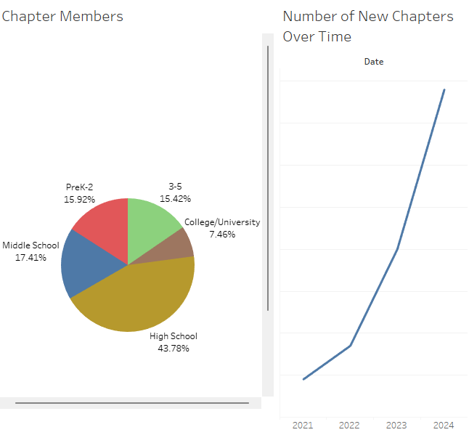
Leadership
Chapter Map
© National STEM Honor SocietyTM

Slide 23
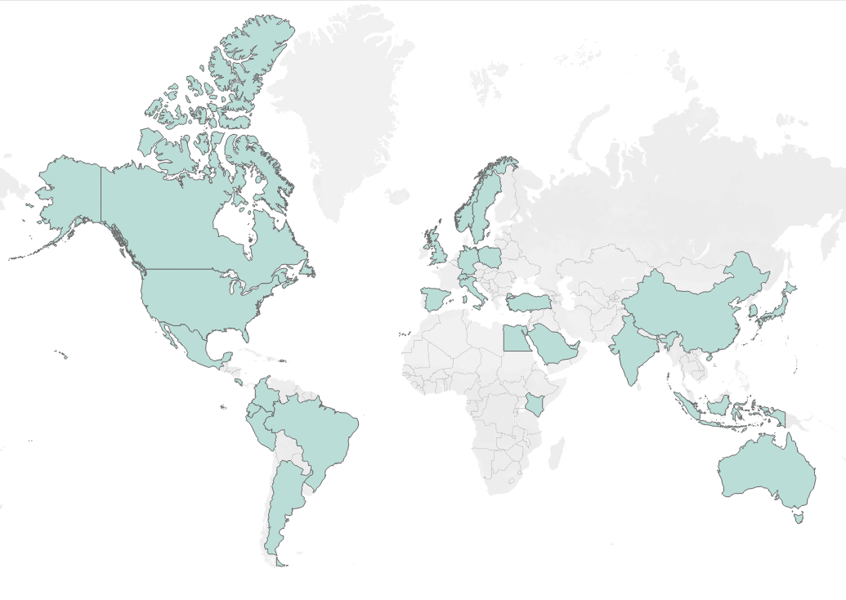
Leadership
International
Expansion
© National STEM Honor SocietyTM

Slide 24
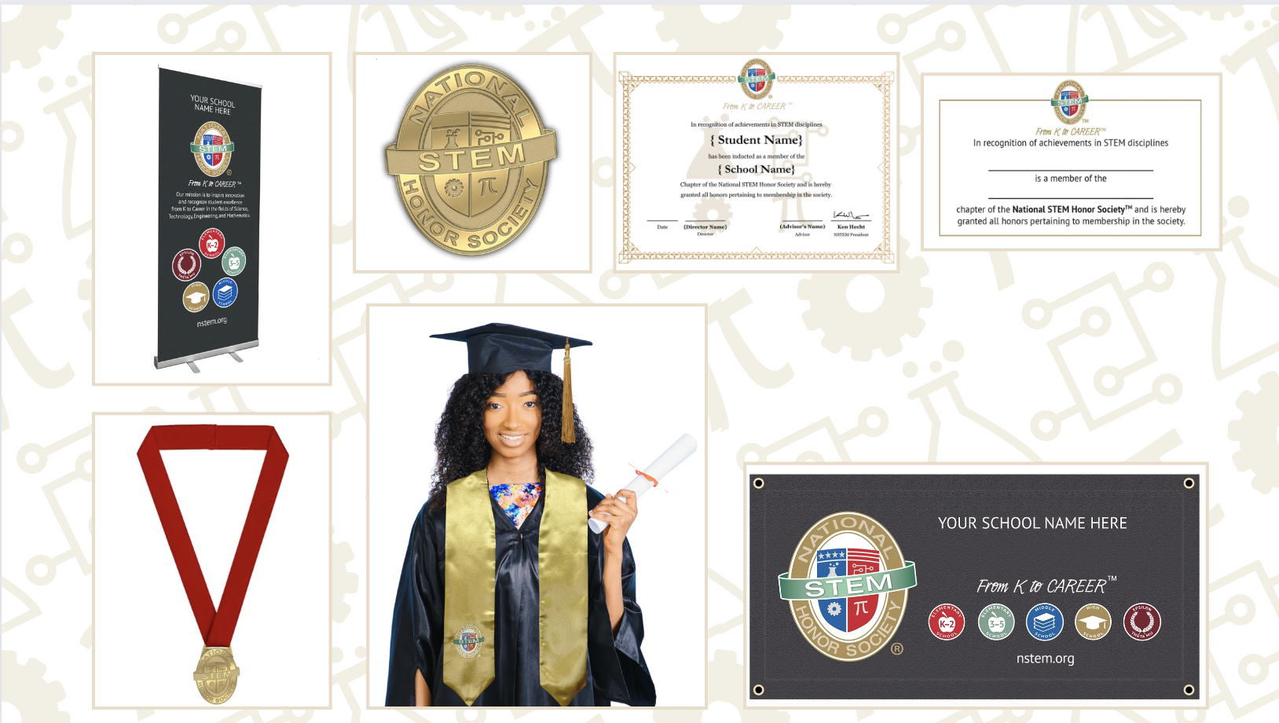
Exclusive
Chapter Merchandise
© National STEM Honor SocietyTM
Notes:
Students who have an IGM can access this merchandise through their dashboard, all chapter-based students, let your advisor know about this side of the shop!

Slide 25
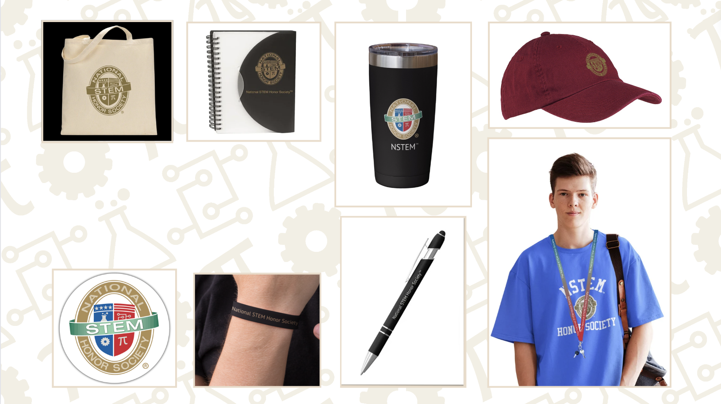
Apparel & Accessories
© National STEM Honor SocietyTM
Notes:
This is open to all students, regardless of if they are an IGM or in a chapter
Advisors can also order from this side of the shop for their chapter

Slide 26
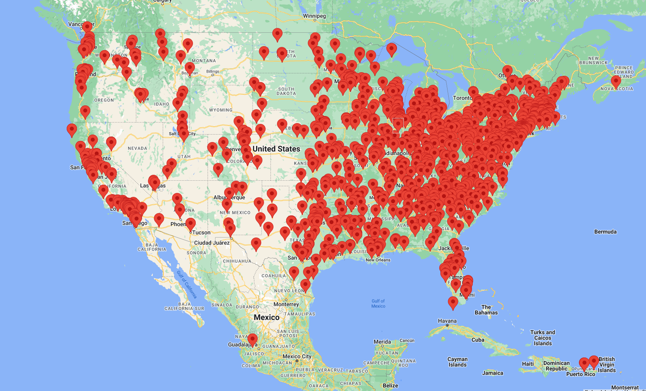
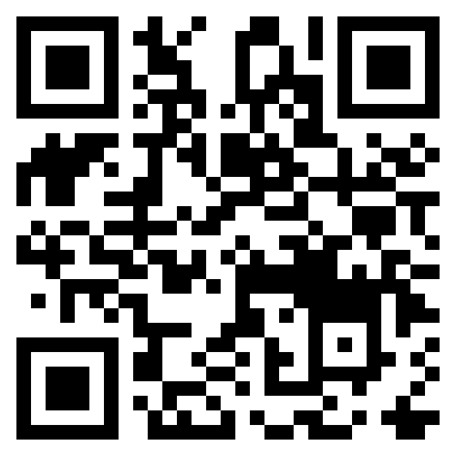
Accredited College
& University Internship
© National STEM Honor SocietyTM
Notes:
We hold accreditation from 1500 colleges and universities nationwide. Our official recognition by admissions boards solidifies our standing as a trusted and reputable institution for prospective students seeking academic excellence and growth
JUST FOR COLLEGE & HS students

Slide 27








Thank You!
nstem.org
© National STEM Honor SocietyTM
Notes:
We are super excited to welcome you to our exponentially growing community. We can’t wait for you to get started and to see the things that NSTEM can help you accomplish.

